Slide 1



Innovative Instruments in the Agroforestry Sector
Lima, Peru, 29.05.2018
Innovative Instruments in the Agroforestry Sector
Lima, Peru, May 29th 2018

Slide 2

DISCLAIM
This material was produced for its exclusive use for the Workshop "Green Titles and Sustainability in Latin America, Trend or Agent of Change, Panel on the Use of Agricultural and Forestry Land", promoted by the Inter-American Development Bank - IDB and the Latin American Association of Institutions Financial Services for Development - ALIDE and should not be used for any other purpose and the content may not be reproduced, redistributed or copied in whole or in part without the express permission of Banco do Brasil. The opinions and reviews contained herein are subject to change at any time without notice. This material has been prepared solely for informational purposes and does not constitute an offer, invitation to tender, or recommendation to enter into a transaction. Nothing in these materials shall be construed as accounting, legal or tax. The objective of the session is to share knowledge about the structural challenges of a green title, especially for the agribusiness, livestock, forestry and land use sectors, which are important sectors for the Latin American economies, but for which, however, there is little experience in the green bond market.

Slide 3











Founded in 1808
54.4% controlled by the Federal Government
1st company listed on the stock exchange in Brazil
Large, diversified and stable funding base
Business diversification including:
Banking Services
Insurance
Capital Markets
Asset Management
Means of Payment
International Franchise
3

Slide 4
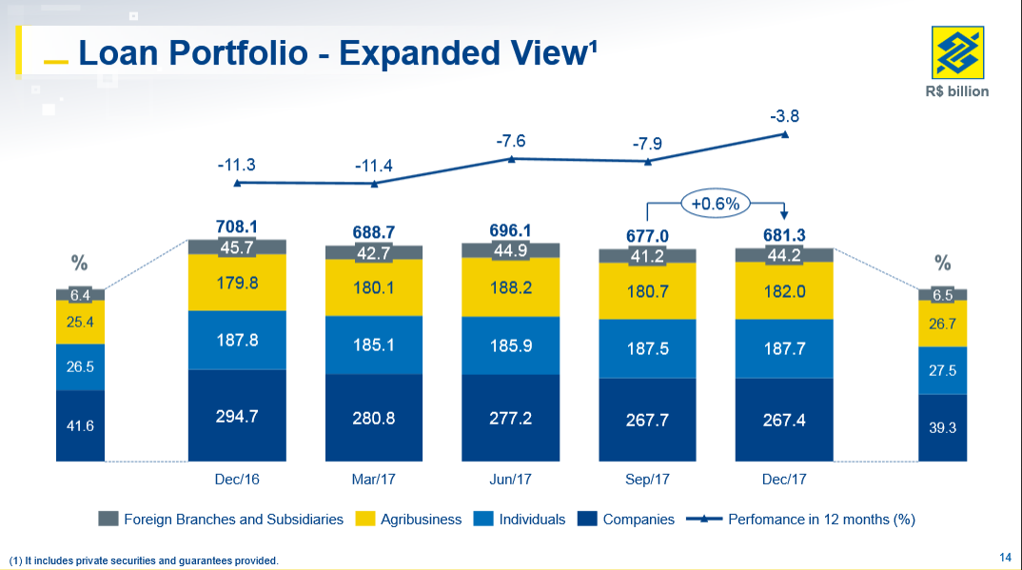

Slide 5
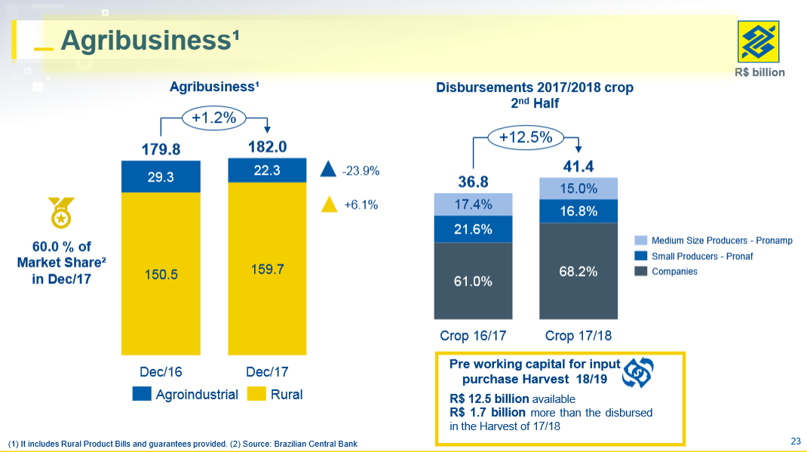

Slide 6
Potential of Low Carbon Agriculture in Brazil
PASTURE RECOVERY
NO TILLAGE
INTEGRATION
AGRICULTURE
LIVESTOCK
FOREST
40 MM ha
25 MM ha
2 MM ha
TARGET MAPA
TARGET MAPA
TARGET MAPA
15 MM ha
8 MM ha
4 MM ha
Proposal
MAPA
2010-2020
EMISSION REDUCTION
EMISSION REDUCTION
EMISSION REDUCTION
101,7 MM tCO2e
year
Proposal
MAPA
2010-2020
Proposal
MAPA
2010-2020
14,6 MM tCO2e
year
27,1 MM tCO2e
year
TOTAL COST
TOTAL COST
TOTAL COST
R$ 60 bi
R$ 12 bi
R$ 18 bi
Fonte: Adaptado SAE/PR
Notes:
Pasture – R$ 4.000,00
No tillage – R$ 1.500,00
LPF – R$ 4.500,00

Slide 7
Potential of Forest Recovery in Brazil
Current Paradigm
Loss of agricultural income;
High cost for recompor;
Compounding with natives does not generate income;
Inexistence Chain Forest Recovery.
Legal Reserve
How to Encourage Forest Recovery?
80% Forestry in the Bioma Amazonia
35% Closed in the Legal Amazonia
20% Other areas
Potential: 16/18 millions
Hectares
Total Cost: R$ 80 billions
Notes:
R$ 5.000,00 ha

Slide 8
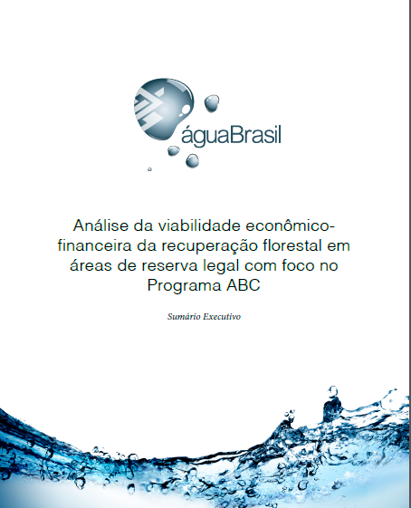
Potential of Forest Recovery in Brazil
New Forest Code
Identifies models and technical guidelines;
Evaluates the economic-financial viability of the models.
Recovery 50% Native
50% Exotic

Slide 9
Innovative Instruments in the Agroforestry Sector
3rd
Context
2nd
Context
1st
Context

Slide 10
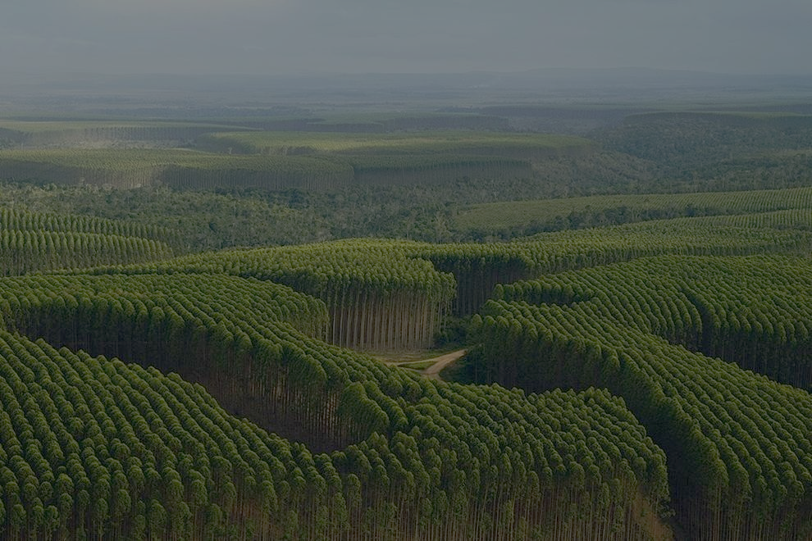
1st
Context
Large agroindustries with access to the international capital market and with natural hedge, that is, able to take on debt in foreign currency.
Case 1 - BRF
2015
Risk Brazil – Investment Grade
Amount: EU 500 milhões
Tenor: 7 anos
Yield: 2,8%
Bank: structuring and distribution
Morgan Stanley, MUFG, ABN AMRO, Ccredit Agricole CIB, Lloyds Securities, Multi-Banco Secutiries, Siebert Brandford SH.
Case 2 – SUZANO PAPEL E CELULOSE
2016
Risk Brazil – Not Investment Grade
Amount: USD 500 milhões
Tenor: 10 anos
Yield: 5,875%
Bank: structuring and distribution
Banco do Brasil Securities / Bradesco BBI / BTG Pactual / Itaú BBA / JP Morgan / Santander

Slide 11
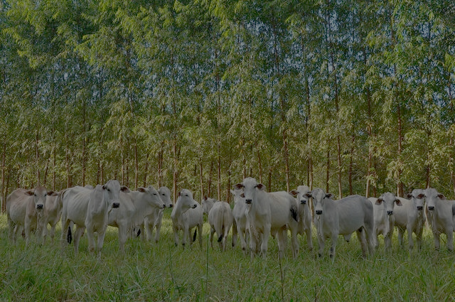
2nd
Context
Medium and large producers, access rural credit via SFN, do not access capital markets and do not assume debt in foreign currency.
Selic: 6,5% a.a.
Cost ABC Financing: 7,5% a.a.
Raising Funds – Capital Markets
USD 5,50 % p.a. = BRL 9,75 % p.a. (150% Selic)
BRL 9,75% p.a. + spread = BRL 12,75 % p.a. (196% Selic)
Raising Funds - Subsidized (GCF)
USD 0,75% a.a. = BRL 3,90% a.a. (60% Selic)
BRL 3,90% a.a. + spread = BRL 7,9% a.a (121% Selic)
Notes:
Amount: US$ 185mn
Tenor: 5-year
Interest rate: 0.75% USD Fixed
Interest payment frequency: annual
Principal: bullet
As the Selic rate represents the remuneration of financial institutions in transactions with government securities, it is commonly used as an index by which interest rates in Brazil are set.
USD/BRL swap Pricing under ISDA regs ;
5 Year USD 0.75% Fixed act/360 vs 61% BRL CDI% bus/252 day basis annual coupons both sides

Slide 12
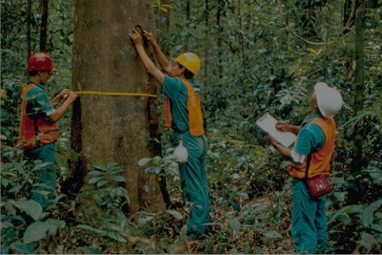
3rd
Context
Need to generate attractiveness for low carbon farming activities and forest recovery
Green Economy Fund
Private Placement of Impact Capital
Final Cost of
Target Financing
BRL 4,5 % p.a.
BRL 5,5% p.a.

Slide 13
Flowchart
Market Scenario
5,50 % a.a.
COUNTRY
Private Placement of Impact Capital
OFFSHORE
Investor of
Impact
Local
Fund
1
Green Bond - US$ 100 MM / 4,00 % p.a. / 10 years
5
R$ 160 MM / 7,5% p.a. / 8 years – 3 years grace period
3
4
FI OFFSHORE
Management or financial transfer of part of the spread generated with funding
FI
9
2
US$ 100 MM / 5,50 % p.a.
R$ 160 MM / 7,5% p.a. / 8 anos – 3 years grade period
Specific Account Bonus
6
Purchase of Sovereign Bonds
Rural Producers
R$ 35 MM (∆ 4,00% p.a. e 5,00 % p.a.)
8
7
40.000 hectares recovery
R$ 17,5 MM (∆ 5,00% p.a. e 5,50 % p.a.)
ENVIRONMENTAL
PERFOMANCE
Monitoring
Notes:
01 – BB emite GreenBond (Private Placement) em favor de Investidor no valor de US$ 100 milhões, com pagamento anual de 4,00 % a.a. US$, com prazo de amortização de 10 anos.
02 – BB Exterior (Grand Cayman): aplicações/operações a taxa superior à captação dos recursos, obtendo assim spread positivo.
03 – As aplicações/operações realizadas no exterior gerarão um spread excedente de X US$, uma vez que a captação será abaixo do mercado.
04 – O spread excedente, ou seja, a diferença entre a captação a e aplicação dos recursos, deduzida a remuneração do BB, será transferida (gerencial ou financeiro) para conta do BB Brasil a fim de compor caixa para pagar bonificação por performance ambiental de produtores rurais.
05 / 06 – Os financiamentos serão concedidos com recursos do FCO, sem alterações nas condições já predefinidas pelo Programa.
07 – Com base no montante para bonificação ambiental será estimado o valor de bonificação por hectare, que condicionará a quantidade total de hectares a serem recuperados e o montante total de financiamento a ser concedido.
08 – A bonificação será deduzida da parcela ou creditada após o pagamento da parcela pelo produtor rural na data de amortização das prestações do financiamento do FCO.
09 – A Performance Ambiental (hectares recuperados) é reportada ao Investidor.

Slide 14
BONUS SCHEME
US$ 100.000.000,00
Spread 1% p.a.
8 years
Project Cost
R$ 4.000,00/ha
Local Fund
US$ 1.000.000,00 / year
7,5% p.a.
Total Project Cost
R$ 5.736,00/ha
PMT: R$ 717,00
R$ 3.500.000,00 / year
Estruturação de Captação Capital de Impacto
Bonus per Operation/ha
R$ 868,00
Private Placement of Impact Capital
Project Interest Rate
R$ 1736,00/ha
Environmental Bonus
50%

Slide 15
LAND USE ENVIRONMENTAL PERFORMANCE
YEAR 1
YEAR 10
CONSERVATION APP/RL
200 a 750 ha/
Property
16.000 a 60.000
160.000 a 600.000
INTENSIFICATION
Restoration 50 ha/ Property
4.000
40.000
FOREST RECOVERY Conpensation
800
FAMILIES BENEFITED
Properties
400-1500 ha
80
Private Placement of Impact Capital
Adherence and Compliance with PRA
Notes:
Condições do Programa (recursos para bonificação: spread 1%)
Público-alvo: produtores com propriedades entre 400 e 1.500 ha
Financiamento: 50 ha por produtor/propriedade
Bônus ambiental: 50% dos juros após aplicação do bônus de adimplência (R$ 750,00)
Área mínima conservada (RL/APP) por propriedade: metade da área total da propriedade (Código Florestal – RL no Bioma Amazônia, no mínimo 50% do imóvel rural – entre 200 e 750 ha); ou adesão e cumprimento do cronograma do PRA (Programa de Regularização Ambiental) Estadual

Slide 16



GREEN ECONOMY FUND
Low Carbon Agriculture
Forest Conservation and Recovery
GREEN
ECONOMY
FUND
  INVESTMENT / FINANCING
  Social Enviroment
Sustainable Forest and Extrativism Management
Financial
Institution
Energy Efficiency and Renewable Energy Generation
It is intended to support individuals, corporations, governments, and third-sector organizations that aim to implement projects, studies, and entrepreneurship that contribute to transition to low-carbon economy and conservation of ecosystem services, as well as the reach of NDC .
Urban Mobility
Water Resources and Sanitation
Others
Instruments: concessional financing, payment for direct and indirect environmental services, constitution of assets, guarantees, securitization.

Slide 17



Monitoring
DONORS / INVESTORS
Information
Government Agencies
Independent Auditors
ENTRANCE OF
FUND
Technical Assessment
SOCIAL ENVIRONMENTAL INVESTMENTS
Foundation
Execution
Institutions
GREEN
ECONOMY
FUND
Not Reimbursement
FI
PAYMENT FOR ENVIRONMENTAL SERVICES
FI
Not Reimbursement
GREEN
ECONOMY
FUND
Personal
CONSTITUTION OF GUARANTIES AND ASSETS
FI
Reimbursement
Companies
CONCESSIONAL SOCIAL ENVIRONMENTAL FINANCING
Reimbursement
FI
Government

Slide 18








CHALLENGE – SOCIAL ENVIRONMENTAL SAFEGUARDS
COMPLIANCE SYSTEM
Co
I
Social Environmental Management System FI
SOCIAL ENVIRONMENTAL AUDIT
People
Internal Control FI
II
Climate
Hidric Risk Assessment
Social Environmental Impact Assessment
Potential Previous Impacts Assessment Tool
III
Water
MRV
GHG Emission Monitoring
IV
Forest
V
Biodiversity

Slide 19
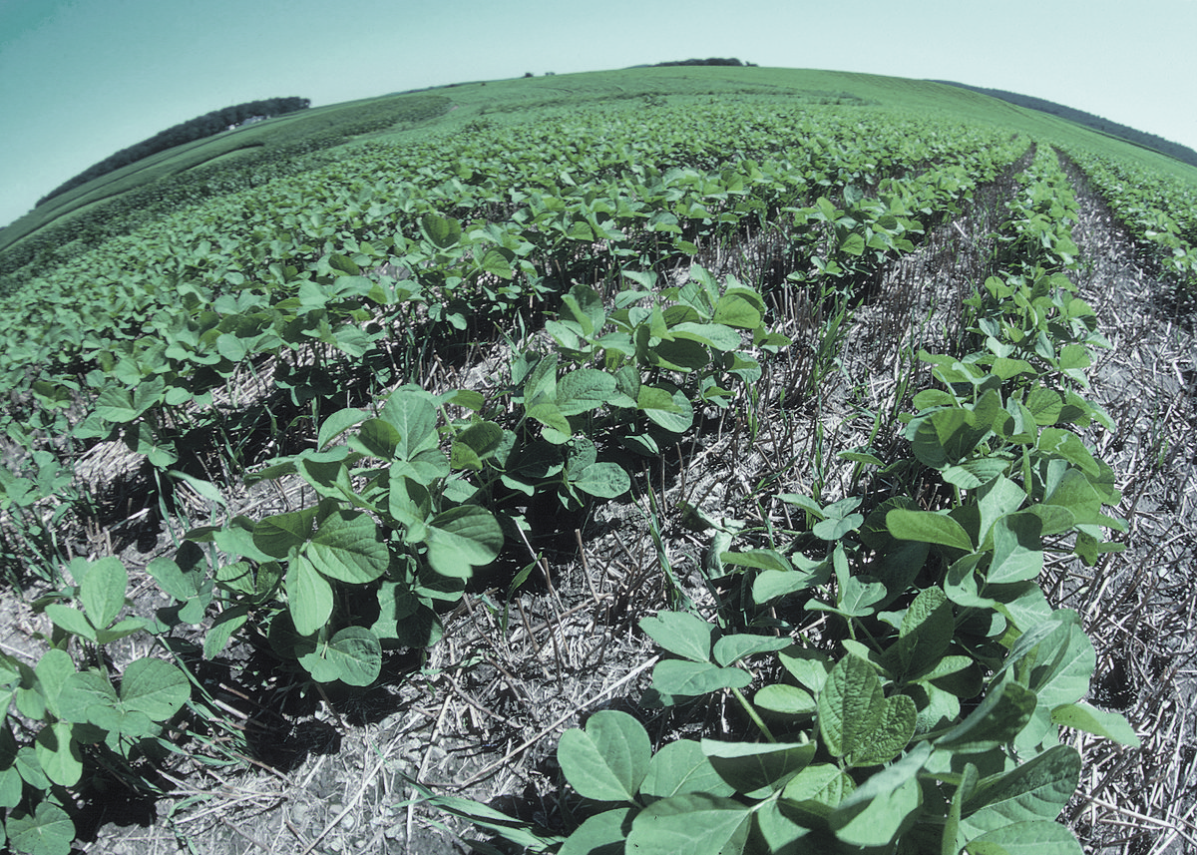
Mercado Interno
Structural Challenges for the Development of the National Green Bonds Market
Structural:
a) low liquidity secondary market;
b) concentrated investor market and little participation of personal investors and foreigners;
c) competition with public securities, eg NTN-b.
Specific:
a) increase of the time of placement;
b) choose standard (protocol);
c) perception of greater risk when it comes to new technologies;
d) disclosure of economic and socio-environmental benefits.
Suggested approach: start with those companies that already have governance and advanced socio-environmental policy, that is, those that are already listed in ISE and DJSI and for investors who have already joined the PRI.
CRA Verde is an option to capitalize on large agribusiness companies with the possibility of attracting local investment, pension funds, qualified investors and investors in general, if there is a tax incentive, at least initially.

Slide 20
CRA - OPERATIONAL FLUXOGRAM
1 - Producers, cooperatives and agribusiness companies buy inputs in financed operations, backed by receivables;
2 - The company / cooperative supplying the goods delivers the goods and accumulates receivables. These remain in the treasury waiting for the maturity, immobilizing part of the working capital;
3 - A securitization company, organized in the form of a Specific Purpose Entity (SPE), is the bridge between the company that holds the receivables and the investor. Structure the operation between the parties;
4 - The securitization company accepts discounted receivables and issues a CRA;
5 - Sell the CRA, backed by the receivables, to the investor;
6 - Upon expiration, the investor will receive the payment of receivables directly from its issuers. Therefore, it exposes itself to the risk of rural producers or cooperatives.
PRODUCER/
COOPERATIVE
6
1
2
AGRIBUSINESS COMPANY/COOPERATIVE
3
3
SECURITIZATION COMPANY
4
INVESTORS
5
CRA ISSUANCE
Notes:
It is free from IR (for PF) and IOF;
In any case, it is exempt from IOF;
There is no administration, performance or custody fee;
It is very flexible, offering several conditions of profitability, liquidity and term;
It is an excellent medium-term investment option;
Usually, it has much more attractive return / risk return rates than traditional CDBs, DI funds or Direct Treasury;
When dealing with fixed income, when investing in CRA, the investor has a forecast of the cash flow and amortization of the security, that is, he knows in advance the flow of payments that the title offers.
s directly from their issuers. Therefore, it exposes itself to the risk of rural producers or cooperatives.
Does not have the FGC guarantee The first disadvantage is that the CRA does not have the guarantee of the Credit Guarantee Fund (FGC). Unlike private bank issuing assets (such as CDBs, LCs, LCIs and LCAs), which are guaranteed by the FGC, private issuances are not guaranteed. Private issues have their own guarantees, defined for each issuance.

Slide 21

THANK YOU!
Banco do Brasil S.A
Strategy and Organization Directorship
Inovation and Social Environmental Responsability Executive Management
Green Economy Division
E-mail: direo.economiaverde@bb.com.br

