Slide 1

Innovative Financial Instruments to Support Energy Efficiency
Residential Solar PV Lease and Energy Efficiency ESA with PosiGen
November 15, 2016

Slide 2
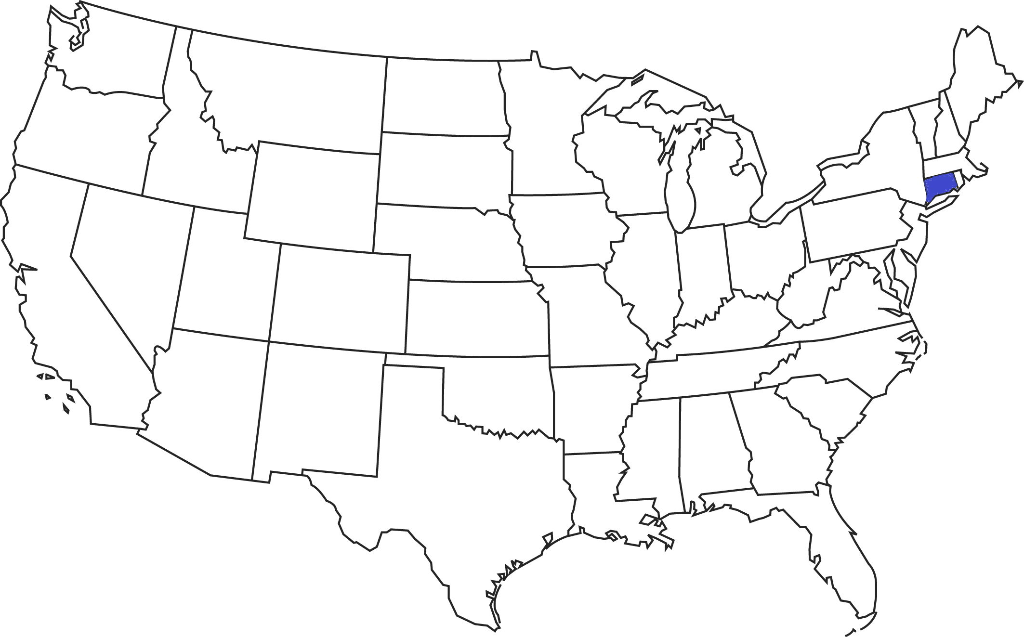



Connecticut Microcosm of the United States
Region – New England
Population – 3,597,000
Gross State Product – ~$225 B
Diversity – metropolitan areas in Connecticut – New Haven (#1) and Hartford (#3) are the most representative of a normal America¹ in terms of age, education attainment, race, and ethnicity
Buildings – some of the oldest, most energy inefficient, and H&S issues
Energy Costs – highest electricity costs in then “lower 48” states
Grid Reliability – 5 major storms in the past 5 years with unacceptable outages
Population
Size
Economy
REFERENCES
‘Normal America’ Is Not a Small Town of White People by Jed Kolko of FiveThiryEight.com (April 28, 2016)
2
Notes:
Population about the same as Uruguay
About the same size as El Salvador
About the same size economy as Ecuador

Slide 3
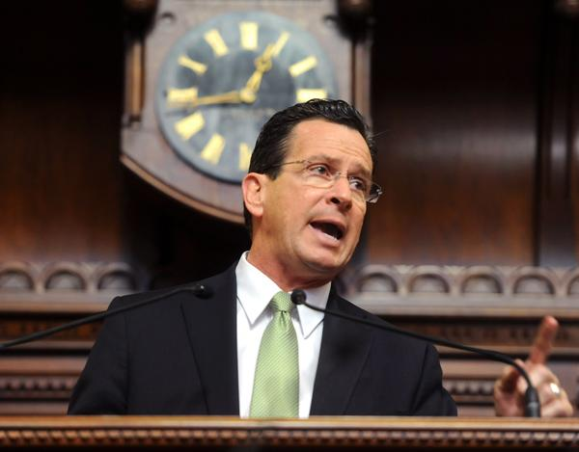

Connecticut Green Bank About Us
1st State-Level Green Bank in the U.S.
Quasi-public organization – created by PA 11-80 and “use private sector disciplines to achieve public sector goals”
Focus – finance clean energy (i.e. renewable energy, energy efficiency, and alternative fuel vehicles and infrastructure)
Support – supported by a $0.001/kWh surcharge on electric ratepayer bills (about $10 per household per year) that provides approximately $27-30 MM a year for investments, RGGI about $5 MM a year for renewable energy, federal competitive solicitations (i.e. SunShot Initiative) and non-competitive resources (i.e. ARRA-SEP), private capital, and private foundations
3

Slide 4



Solar PV Lease and EE ESA PosiGen
Home
(New Haven – Oil Heat)
Solar PV
(Lease)
Energy Efficiency
(ESA)
+
+
$59,250 HHI
High Energy Costs
High
Energy Burden
$55 to $100/month Lease
Net $ Savings - Solar
Moderate
Energy Burden
$10/month ESA
<<Additional Savings>>
Net $ Savings –
Solar + EE
Reasonable
Energy Burden
4
Notes:
Partnership on solar deployment for low to moderate income customers, a traditionally underserved market.
Example of combining innovative financing and incentives, both for solar and for energy efficiency to bring energy cost burden IN LINE with that of an upper income band household.
Walk through the impact this can have on a household.
Talk about why a solar LEASE for LMI as opposed to a loan for purchasing solar (not enough tax burden to take advantage of federal tax credits, so economics of owning don’t work yet given the installed costs in our market – would need to be in the low $2’s).
Given electric costs our LMI residents are incurring and the inefficiency of their homes, just going solar at a below market lease rate, which PosiGen provides, is going to save money. EE is the icing on the cake. The $10/month ESA is essentially a way to pay for $2400 of EE over 20 years w/ no upfront costs, and reap the savings benefits.

Slide 5



PosiGen CT, LLC Capital Structure – $15-$20 MM
Connecticut Green Bank
Senior Debt
Sub Debt
LMI Incentive
Equity Capital
Manager Level
Capital
Project Level
$
Tax Equity
System
Installation
Monthly Solar PV Lease and Energy Efficiency ESA Payments
Customer
5
Notes:
Green Bank’s subordinated debt provides credit enhancement and attracts the senior debt capital from Enhanced. Leverage ratio potential of 5:1 as the portfolio grows. Both lenders provide debt to the structure at the manager level, meaning the debt is “back-levered” (i.e. behind) the tax equity from US Bank. The lenders have collateral in the projects (the lease and ESA payments, the PBI payments, the solar equipment itself) after the ITC tax recapture period ends (that is, after about 5 years). The Green Bank’s “good housekeeping seal of approval” is also helping PosiGen attract new tax equity (both in 2016 and looking towards future growth)
Green Bank’s subordinated debt was structured to attract senior debt, align with tax equity, and leverage project returns, proving to be a critical credit enhancement to the capital structure of the PosiGen, CT SPE, lowering the overall cost of capital of the structure and helping deliver lower cost energy services (Solar + EE) to a broader array of underlying customer.
Green Bank’s subordinated debt attracted senior debt from Enhanced Capital due to the nature of Green Bank’s diligence on the project and Green Bank’s subordinated position in the secured collateral (the lease and ESA payments, the PBI payments, the solar equipment itself), helping reduce the overall risk exposure to the senior lender.
The position of the debt in the financing structure, secured at a level one-step removed from the project and Tax Equity positions, creates a natural “back-levered” position which reduces the Tax Equity’s exposure to ITC recapture risk and maintains a financing relationship that allows for “no FICO score” based LMI leases.
With a leverage ratio potential of 5:1 private capital to Green Bank exposure as the portfolio grows, and Green Bank’s “good housekeeping seal of approval” continuing to help PosiGen attract new capital, Green Bank is confirming a “proof of concept” that the ability to effectively diligence, structure, and finance projects with limited public capital can create efficient public-private capital partnerships.

Slide 6



PosiGen Solar for All Campaign
Target – 1,000 participating households for 6.00 MW of solar PV deployment
Solar PV Progress – 352 installations in 15 months for 2.3 MW of solar PV deployment
$55-$100 solar PV lease payment/month for 20 years
74% of contracts are LMI*
50% of customers move forward (suitable)
Energy Efficiency Progress
100% of households installing solar PV undertake Direct Install EE measures
86% of households also undertake “deeper” energy efficiency projects * (e.g., insulation, thermostats, etc.) through $10 ESA payment/month for 20 years
Jobs – 33 hired in 2015, 19 additional in 2016 and 30 more planned
New Haven
Hartford
Applications
1170
Suitable Rooftops
Move Forward
Installations In Process
350/2.3 MW 240/1.5 MW
Bridgeport
New London
6
* Based on most recent quarter’s experience, 3rd quarter of 2016
Notes:
We launched our 4th community campaign with PosiGen in the City of New London in September
Green Bank has advanced $3.7M of the $5M initial sub-debt commitment for the 352 installations representing ~2.3MW and $10.2M in leases (6.5 kW avg. system size)
Current pricing:
4.5 kW / $54.99 per month
6.0 kW / $69.99 per month
8.0 kW / $99.99 per month
EE ESA / $10 per month
Mention FREEDOM

Slide 7


Slide 8
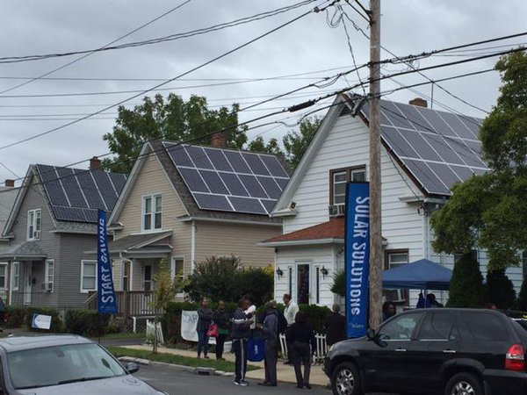


Slide 9
Connecticut Green Bank Mobilizing Investment
 | FY 2000- FY 2011 (CCEF) | FY 2012- FY 2016 (CGB) ¹ | FY 2016 (CGB) ¹
Model | Subsidy | Financing | Financing
Years | 11.00 | 5.00 | 1.00
Energy (MW) | 43.1 | 192.3 | 74.4
Investment ($MM) | $349.2 | $915.8 | $314.1
Leverage Ratio | 1:1 | 5.6:1 | 6.6:1
% as Loans | 10 | 46 | 53³
Jobs (Job-Years) | - | 11,594 | 4,443
Environment (TCO₂) | - | 2.2 | 0.9
Mobilizing private investment in the economy to reduce energy burden, create jobs, and reduce GHG emissions
REFERENCES
Approved, closed, and completed transactions through FY 2016 – included in Draft FY 2016 Comprehensive Annual Financial Report
Balance sheet assets as of June 30, 2011 for FY 2011 and June 30, 2016 for FY 2016
Subsidies provided by the Green Bank through the Residential Solar Investment Program are returned over time through the sale of SHRECs through 15-year contracts with the EDCs for Class I RPS compliance

Slide 10
Thank You!
Bryan Garcia
President and CEO
845 Brook Street
Rocky Hill, CT 06067 bryan.garcia@ctgreenbank.com

