Slide 1




Energy Savings Insurance
March, 2017

Slide 2

ESI Methodological Approach – Key toolkit features
Agenda
Evolution of the ESI model (Colombia - Mexico - El Salvador)
Lessons learned
ESI replication opportunities

Slide 3




Evolution of the ESI model
(Colombia - Mexico - El Salvador)
Energy Savings Insurance
Financing
©√
Validation
Insurance
Contract
Supporting actions
Market assessment
Promotion strategy
Capacity building
Implementation

Slide 4
Evolution of the ESI model
(Colombia - Mexico - El Salvador)
Colombia - Bancoldex
Funding from CTF and IDB
EE Technologies:
Air conditioning
Climatic automation
Solar water heaters (preheating and swimming pools)
Cogeneration
Motors (under review)
Photovoltaic (under review)
Sectors:
Hotels
Hospitals
Food processing (under review)
Chemical, rubber, plastic (under review)
Financing
Retention guarantee of 25% managed by Client
Contract
©√
Risk coverage provided by SURA
Instrument: Insurance
Covering 25% of total value project
Insurance
Validation provided by ICONTEC.
Baseline, projections and actual energy savings calculations are based in the relation between equipment energy consumption and number of occupied beds (hospitals) and occupied rooms (hotels)
Validation

Slide 5
Evolution of the ESI model
(Colombia - Mexico - El Salvador)
Mexico - FIRA
Funding from CTF and IDB
EE Technologies:
Refrigeration
Industrial boilers
Solar water heaters (preheating)
Cogeneration
Engines
Compressed air
Sectors:
Agroindustry
Financing
Retention guarantee up to 10% managed by third party
Contract
©√
Risk coverage provided by ASERTA
Instrument: Surety bond
Covering 100% of total value project
Insurance
Validation provided by ANCE.
Energy savings methodology is based in ISO 50001
Energy Performance Indicators (EnPI) are used to estimate baseline, projections, and energy savings
Validation

Slide 6
Evolution of the ESI model
(Colombia - Mexico - El Salvador)
El Salvador - Bandesal
Funding from GCF and IDB
EE Technologies:
Refrigeration
Air conditioning
Electric motors
Industrial boilers
Sectors:
Industrial
Commercial
Buildings
Financing
Retention guarantee 10% (managed by third party).
Contract guidelines for clients and providers
Contract
©√
Risk coverage provided by Asesuisa
Instrument: Surety bond
Covering under discussion (target 100%)
Insurance
Validation provided by DQS.
Energy savings methodology is based in ISO 50001
Energy Performance Indicators (EnPI) are used to estimate baseline, projections, and energy savings
Validation

Slide 7
Lessons learned
Local market
Consistently found same financial and non-financial barriers and preconceptions of enterprises for investing in EE projects
Strong commitment and engagement of the NDB to develop the program
Providers
Engage strong technology providers and make clear the business opportunities. It is easier to engage providers that offer “new technology” as they have the challenge to show credibility and ESI mechanism provide credibility to client.
Support and build capacity of providers is key
Risk coverage
identify the more suitable risk coverage product (insurance/surety), and engage local company
Support the risk coverage company to understand the associated risks; this would have an impact on the risk perception and premium costs

Slide 8
Lessons learned
Validation
Credibility, technical capacity and “neutrality” of validation entity is key to build trust among partners
Make clear to validation entity that validation procedures should be an easy standardize process
Promotion
Discuss the mechanisms with the market before the launch and receive endorsement
Build alliances with key organizations that facilitate the promotion of the program and strengthen trust
Pilot projects are key to generate market momentum – “no one wants to jump first and be left hanging”
Financing
Technical assistance funding is necessary to build the mechanisms, engage the actors and generate the initial pipeline
Availability of competitive financing is important but addressing trust and risks are key elements

Slide 9
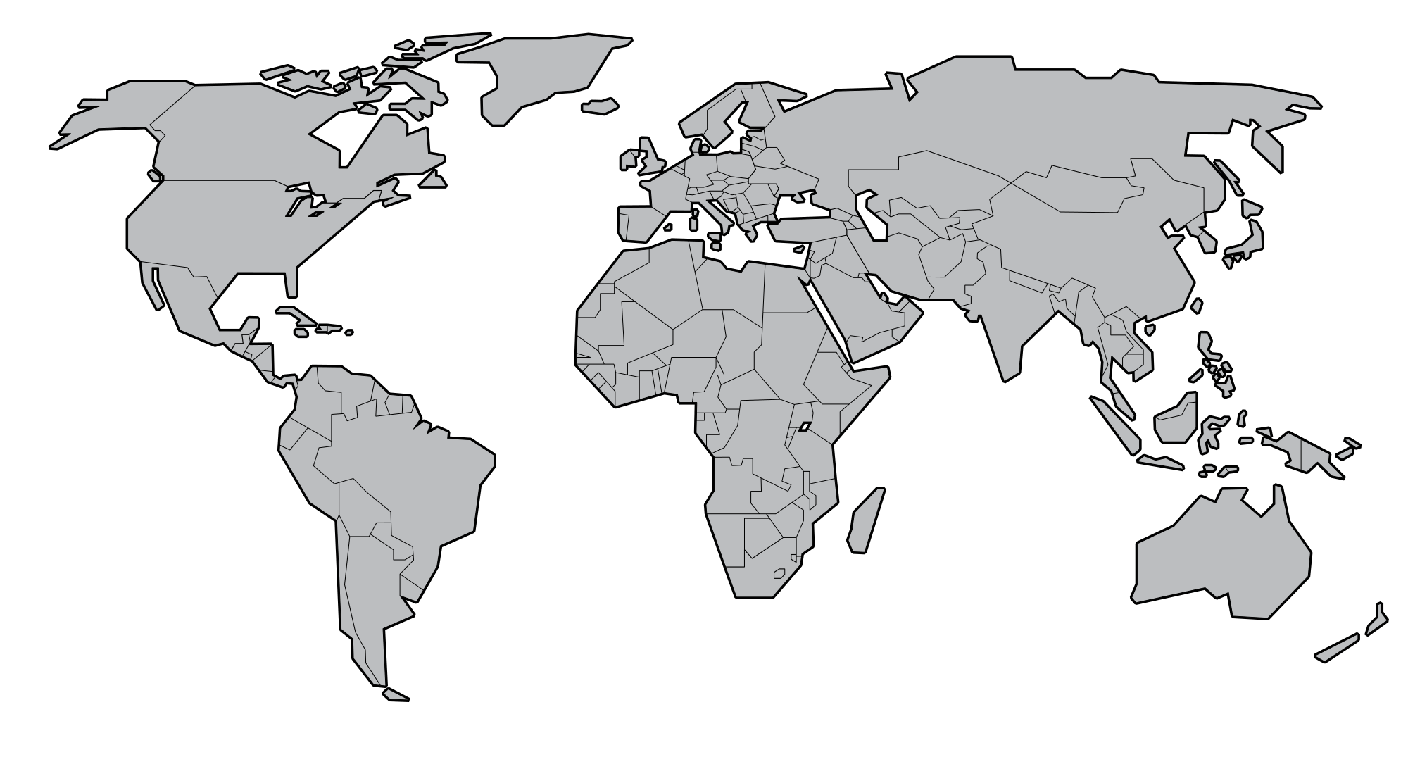
ESI replication
AFD
XacBank
FIRA
Produzcamos
AFD
Banobras
Bancoldex
Bancomext
Bandesal
GOIÁS FOMENTO
AFD
Finagro
COFIDE
BANDES
BRDE
AFD (Agencia Financiera de Desarrollo)
BICE
Implementation
Development
GIZ
CORFO
Anesco
Banco del Estado
Planning
Supported by Danish government

Slide 10
Thank you
Daniel Magallon
BASE – Basel Agency for Sustainable Energy
Elisabethenstr 22, 4051 Basel, Switzerland
P. +41 61 274 04 80; F. +41 61 271 10 10
daniel.magallon@energy-base.org
www.energy-base.org
Twitter: @energy_base

