Slide 1

Energy Savings Insurance, innovative risk management for energy efficiency financing for SMEs
National Development Banks and Green Banks Key Institutions for Mobilizing Finance Towards the implementation of Nationally Determined Contributions (NDCs) and the accomplishment of the Sustainable Development Goals (SDGs)
Rafael Gamboa González
June, 2017

Slide 2
FIRA´s green finance is composed by sustainable projects
FIRA´s sustainable projects portfolio
Sustainable practices (e.g. no tilling techniques, greenhouse production, organic fertilizers)
Efficient use of water (e.g. irrigation technologies)
Renewable Energy (e.g. solar energy, biodigestors)
Energy efficiency
FIRA´s Strategic Plan requires to double sustainable projects between 2013 and 2018 as a Key Performance Indicator (KPI).
Nominal growth = 117%
Observed
Projected

Slide 3
FIRA´s energy efficiency program
In 2013, FIRA and the Interamerican Development Bank commissioned two studies related to the agroindustry´s energy efficiency: of the potential market and of mechanisms to design a Financing Program.
To tackle these barriers and develop these tools, FIRA designed its Energy Efficiency Program with support from the IDB, the (CTF) Clean Technology Fund, and, Denmark.
The main barrier for EE investments is uncertainty about the achievement of energy savings:
Lack of certified providers
Validation of EE projects
Assure the proper installation and operation of the equipment.
In order to minimize uncertainty it is necessary to develop some tools:
Legally binding performance contracts
Energy savings insurance products

Slide 4
A potential Energy Efficiency (EE) market was identified in FIRA´s scope sector.
7,000
Is the number of Agro industrial enterprises in the country, from which 500 are devoted to vegetable packaging activities.
78%
Of the interviewed enterprises have significant energy production costs. This costs could be as high as: 40%
40%
Of the enterprises expressed interest in making EE investments.
77%
Of the enterprises in the study considers that an EE investment should generate enough energy savings to be repaid in 2 to 5 years.
83%
Believes that an EE Project should contribute to generate savings between 20% to 50%
80%
Of the enterprises does not know its energy efficiency potential.

Slide 5
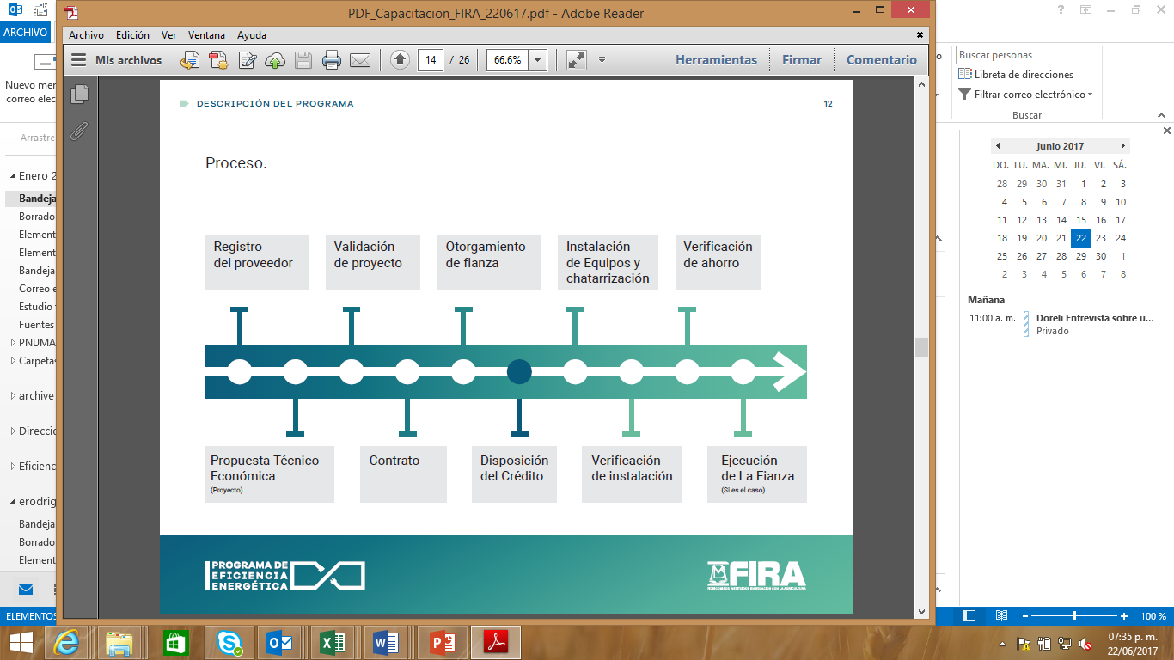
Energy efficiency (EE) projects constitute a Win-Win solution that contributes to mitigate greenhouse gases (GHG’s) and offers economic benefits, however firms do not invest in them
FIRA´s EE program tackles the uncertaintes adding financial & non financial instruments
Technology provider validated by ANCE.
Technology provider designs an EE Project using the Program´s methodology.
EE Project validated by ANCE.
Contract between the technology provider and the agroindustry signed.
The surety bond issued in favor of the agroindsutry.
Credit granted.
EE equipment installed.
Installation of EE equipment verified by ANCE.
Periodic monitoring of energy savings
If necessary, surety bond pays for unachieved energy savings.
1.Technology provider validated
3.- EE Project validated
5.- Surety bond issued
7.- EE equipment installed
9.- Energy savings monitored
2.- EE project designed
4.- Contract signed
6.- Credit granted
8.- Equipment installation verified
10.- Surety bond paid (if required)

Slide 6
Besides enticing agroindustries to take on green investments, FIRA´s Green Program implementation has been challenging as it requires incorporating it in our credit process, involving the whole organization
Defining the strategy towards financing green projects
Board of Directors based on CEO
Detecting Agroindustry needs and barriers; establishing identification and measurement
Environment Division
Negotiating credit lines
Financial Office
Design the operation of the program
Business Development Division
Systems capable of identifing and following on projects
CIT
Identifing clients and explaing and selling credits
Field Team
Monitoring
&
Evaluation
Impact Programs Evaluation Division

Slide 7
The barriers for a massive implementation of new climate finance solutions have to be considered for a 2nd tier National Development Bank.
Different understanding of what is a Green project, which among other things, diminishes the appetite of financers
Excessive requirements from donors and international institutions because of multiple objectives (climate change, SMEs, indigenous rights, biodiversity, among others). It would make sense to start with a single goal and proceed incrementally.
Even though monitoring is a must for Green projects, the more complex it is, transaction costs increase making these projects less desirable, particularly for SMEs.
To involve local financial intermediaries (1st tier), it is crucial to make project identification and measurement part of their credit process.
Having a regulatory framework that forbids or increases the costs of environmentally damaging projects is necessary to mobilize the required amounts to finance green projects.

Slide 8

Energy Savings Insurance, innovative risk management for energy efficiency financing for SMEs
Rafael Gamboa González
June, 2017

