Slide 1

International Climate and Environmental Finance
Mafalda Duarte – Program Manager
Inter-American Development Bank, Washington D.C.
October 7, 2014

Slide 2
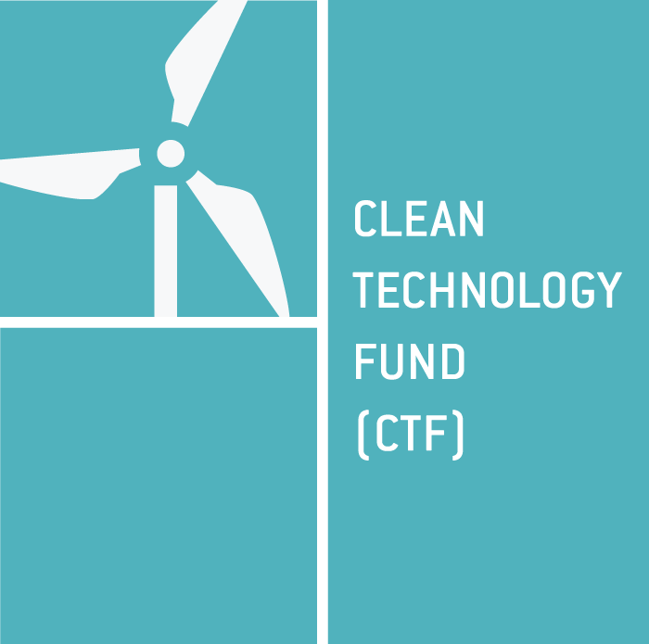

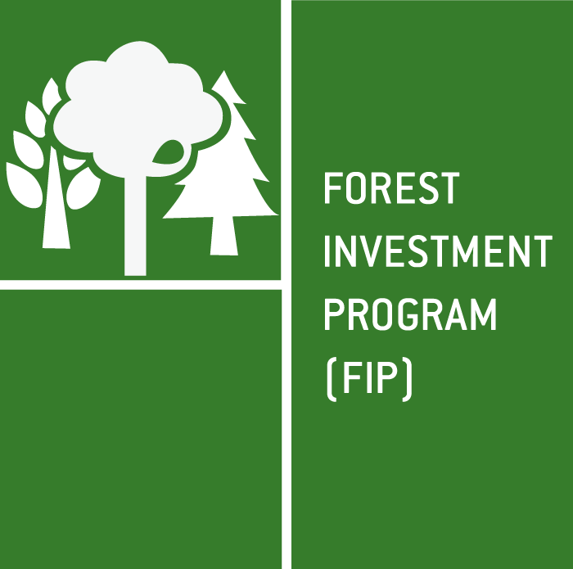
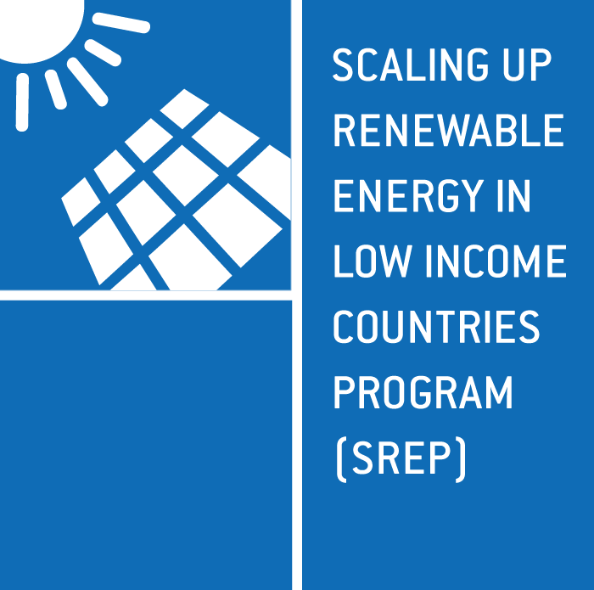
CLIMATE INVESTMENT FUNDS (CIF) $7.6 BILLION (as of August 2014)
$5.3
billion
$1.2
billion
$602.1
million
$523.6
million
Scaled-up demonstration, deployment, and transfer of low-carbon technologies in renewable energy, energy efficiency, and clean transport
Mainstream resilience in development planning and investments
Reduce emissions from deforestation and forest degradation, sustainably manage forests, and enhance forest carbon stocks
Demonstrate economic,
social, and environmental viability of renewable energy
in low income countries
Chile¹
Colombia¹
Egypt
India
Indonesia²
Kazakhstan
Mexico¹
Morocco
Nigeria
Philippines
South Africa
Thailand
Turkey¹
Ukraine
Vietnam
Middle East and North Africa Region
(Algeria, Egypt, Jordan, Libya, Morocco, Tunisia)
Bangladesh
Bolivia²
Cambodia²
Mozambique¹
Nepal
Niger
Tajikistan¹
Yemen
Zambia
Caribbean Region (Dominica,
Grenada, Haiti¹,
Jamaica¹,
St. Lucia¹,
St. Vincent and
the Grenadines)
Pacific Region
(Papua New Guinea,
Samoa, Tonga)
Brazil¹
Burkina Faso
Democratic Republic of Congo
Ghana¹
Indonesia
Lao People’s Democratic Republic
Mexico¹
Peru
Armenia
Bangladesh
Benin
Cambodia
Ethiopia
Ghana
Haiti
Honduras^{1 &} ²
Kenya^{1 &} ²
Kiribati
Liberia
Lesotho
Madagascar
Malawi
Maldives
Mali¹
Mongolia
Nepal¹
Nicaragua
Rwanda
Sierra Leone
Tanzania
Uganda
Yemen
Zambia
Pacific Region (Solomon Islands, Vanuatu)
DEDICATED PRIVATE SECTOR PROGRAMS (DPSP)
PRIVATE SECTOR
SET ASIDE
PRIVATE SECTOR
SET ASIDE
PRIVATE SECTOR
SET ASIDE
Phase I: $40.85m
Phase II: $34.50m
Phase I: $31.30
Phase I: $59.60
Phase II: $32.80
Phase I: $150.0 m
Phase 2: $358.5 m (Haiti,
Honduras, Ghana, Mali)
STRATEGIC CLIMATE FUND (SCF) $2.3 BILLION

Slide 3
CIF PRIVATE SECTOR INITIATIVES: $707.6 MILLION
Honduras
Kenya
Mali
Nepal
SREP set-aside
$92.4 million
Brazil
Ghana
Mexico
FIP set-aside
$31.3 million
PPCR set-aside
$75.4 million
CTF Dedicated Private Sector Programs
$508.5 million
Bolivia
Cambodia
Mozambique
Tajikistan
Haiti
Jamaica
St. Lucia
Chile
Colombia
Indonesia
Mexico
Turkey
Haiti
Honduras Ghana
Mali
Notes:
The DPSP and private sector set asides will support the deployment of an additional $574 million in CIF resources and will contribute to the testing of new modalities to mobilize private sector investments through risk bearing capital.

Slide 4
Some CIF numbers (Sept. 2014)
Funding and Approvals
(million USD)
Public – Private Funding by Program
(million USD)
Co-financing by Source according to MDB Project Approval
Private Sector | MDBs | Government | Bilaterals/ Other Sources | TOTAL
7,175.16 | 8,757.34 | 4,911.04 | 6,429.51 | 27,273.05

Slide 5
Some CIF numbers (Sept. 2014)

Slide 6
Examples CIF Projects with NDBs
Country | MDB - Program | Project | Funding | NDB
Turkey | IBRD - CTF | Private Sector Renewable Energy and Energy Efficiency Project | $100 million - CTF $1 billion – IBRD | Development Bank of Turkey (TKB)
Mexico | IDB – CTF | Renewable Energy Financing Facility | $70.61 million –CTF $70 million – IDB $70 million NAFIN | NAFIN
Mexico | IDB - FIP | Financing Low Carbon Strategies in Forest Landscapes | $15 million – FIP | Financiera Rural
Mexico | IDB – CTF/DPSP | Geothermal Financing and Risk Transfer Facility | $54.3 million - CTF/DPSP $54.3 million – IDB $11.5 million – GoM | NAFIN
Mexico | IBRD - CTF | Urban Transformation Project | $200 million – CTF $150 million – IBRD $2,344 – Gov/PS | BANOBRAS
Mexico | IBRD - CTF | Efficient Lighting and Appliances Project | $50 million – CTF $250.7 million - IBRD $127 million – NAFIN $285.7 million – Others | NAFIN
Mexico | IDB - CTF | ECOCASA Program | $51.1 million – CTF $50 million – IDB | Sociedad Hipotecaria Federal (SHF)
Colombia | IDB - CTF | Energy Efficiency Financing Program for the Services Sector | $10 million – CTF $10 million – Other | Bancóldex
Colombia | IDB- CTF | Technological Transformation Program for Bogota´s Integrated Public Transport System | $40 million – CTF | Bancóldex

Slide 7
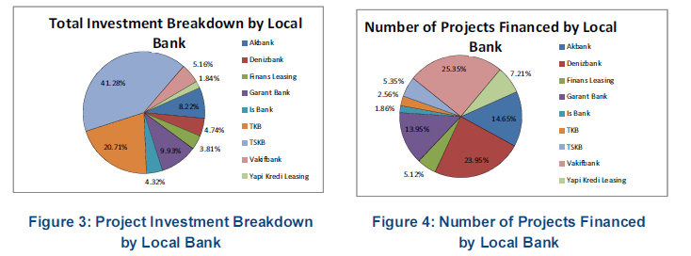
CIF EXPERIENCE: National Development Banks
Turkey: The Private Sector Renewable Energy and Energy Efficiency
CTF Investment: $100 million
MDB Partner: IBRD $1.1 billion ($500 million initial + $500 million after restructure)
Implementing NDB: Türkiye Kalkinma Bankasi A.S (Development Bank of Turkey) TKB (and Turkiye Sinai Kalkinma Bankasi A.S. (TSKB) - a private investment and development bank). Guarantor: Republic of Turkey
 | TKB (US$ m) | TSKB (US$ m) | TOTAL (US$ m)
CTF | 30 | 70 | 100
IBRD | 450 | 550 | 1,000
TOTAL | 480 | 620 | 1,100
TKB and TSKB hold the largest investment share of the CTF supported EE/RE loan portfolio in Turkey with TKB and TSKB accounting for 20.71 percent and 41.26 percent respectively.

Slide 8
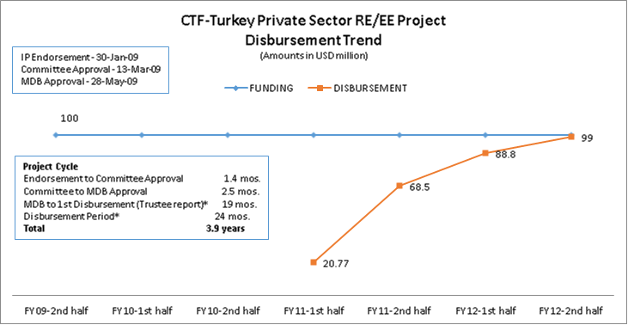
CIF EXPERIENCE: National Development Banks

Slide 9
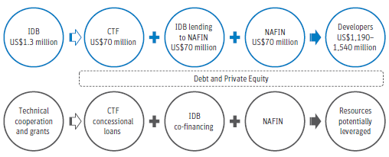
CIF EXPERIENCE: National Development Banks
Mexico: Renewable Energy Financing Facility (REFF)
CTF Investment: $70.61 million ($70 loan; 0.58 in grants; 0.03 in MPIS)
MDB Partner: Inter-American Development Bank ($70 million)
Implementing NDB: Nacional Financiera, S.N.C., (Nafinsa) $70 million
Private: $1,540 million
NAFIN uses the $210 million to catalyze private capital at the project level. Leverage is maximized (no project can receive more than $10 million in CTF financing and no more than 50% of its total investment needs from the REFF)
Estimated Leveraging Effect of CTF REFF and NAFINSA

Slide 10
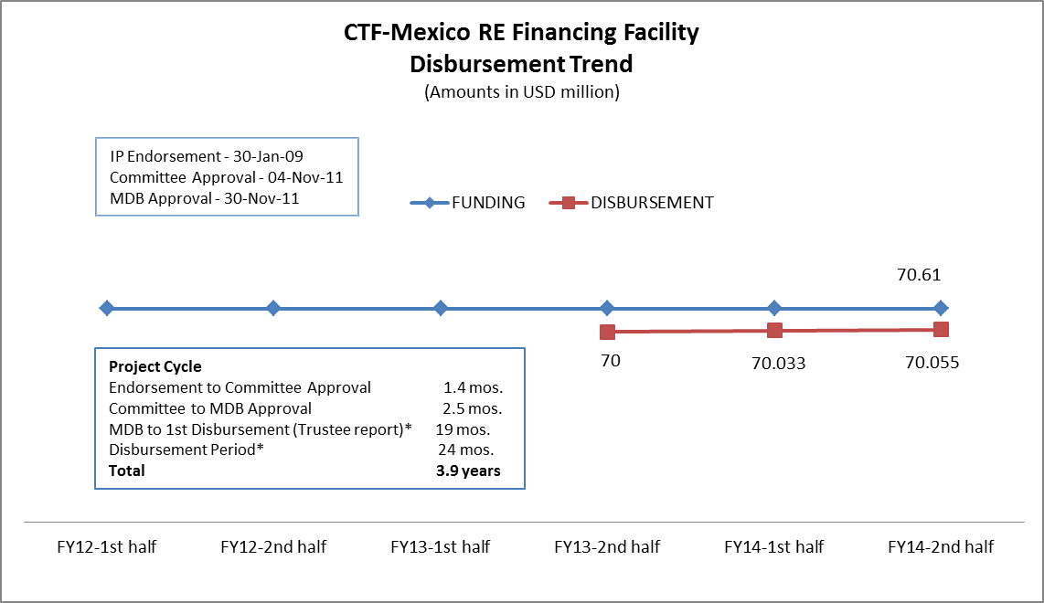
CIF EXPERIENCE: National Development Banks

Slide 11
CIF EXPERIENCE: National Development Banks
Mexico: Financing Low Carbon Strategies in Forest Landscapes
FIP Investment: $15 million (loan and grant)
MDB Partner: Inter-American Development Bank
Implementing NDB: Financiera Rural
The $10 million loan will be channeled through the dedicated financing line to attend one of the underlying economic causes of deforestation and forest degradation by removing the obstacles that limit access to credit by offering the financial terms and conditions required for these projects.
The $5 million grant will provide additional financial and technical assistance to strengthen the technical, financial and management skills at the ejido and community level for conducting low carbon strategies.
Financing Structure: Loan/Grant provided 100% by FIP through IDB
Component | Source-FIP (US$ million) | Total (US$ million)
Component 1 (Loan) | 10 | 10
Component 2 (Grant) FR institutional capacity Technical assistance for sub-borrowers Collateral schemes | 1.1 2.8 1.0 | 4.9
Monitoring and Evaluation (Grant) | 0.1 | 0.1
 | 10.0 | 5.0

Slide 12
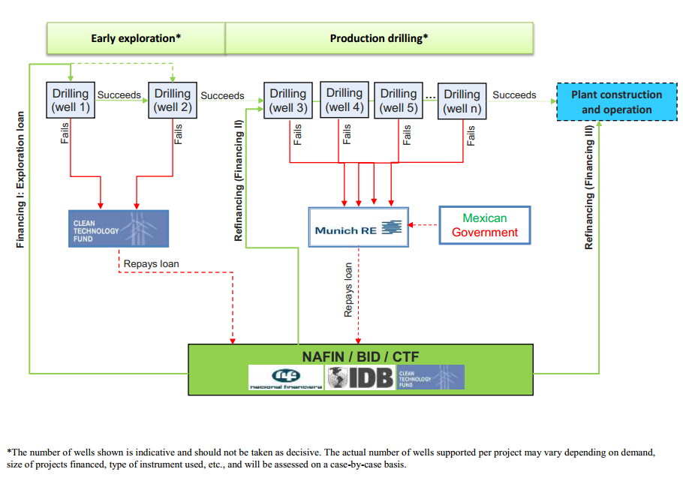
CIF EXPERIENCE: National Development Banks
Mexico: Geothermal Financing and Risk Sharing Facility
CTF Investment: $54.3million ($22.8 million loan and $31.5 million grant)
Other Financing: $40 million
MDB Partner: Inter-American Development Bank
Implementing NDB: Nacional Financiera, S.N.C., (NAFIN) + Govt, SENER and others ($65.8 million)
Expected total co-financing: 1,146 million (Private sector $1,026 million)

Slide 13
CIF EXPERIENCE: National Development Banks
Colombia: Energy Efficiency Financing Program for the Services Sector
CTF Investment: $11.05 million ($10 m loan and $1.05m grant)
Other Financing: $10 million (yet to be secured)
MDB Partner: Inter-American Development Bank
Implementing NDB: Bancóldex (Banco Colombiano de Desarrollo Empresarial y Comercio Exterior) [Colombian Bank for Business Development and Foreign Trade]
Funding Structure: Loan to combine with technical assistance to build capacities of Bancóldex, LFIs and other relevant market actors on the structuring, financing, monitoring and evaluation of competitiveness-enhancing, EE projects. The credit line through CTF funds will be provided by Bancóldex to eligible LFIs so that they, in turn, can offer sub-loans at adequate terms and conditions to eligible hotels and clinics/hospital for the financing of eligible EE investment projects. ) Bancóldex will assume the risks of the LFIs; and the LFIs would assume the sub-borrower’s project risks.
Financing Structure: Credit for onward lending to LFIs
Investment | CTF(US$ million) | BANCOLDEX/IDB | Total (US$ million)
 | 10 | 10 | 20
Percentage | 50% | 50% | 100%

Slide 14
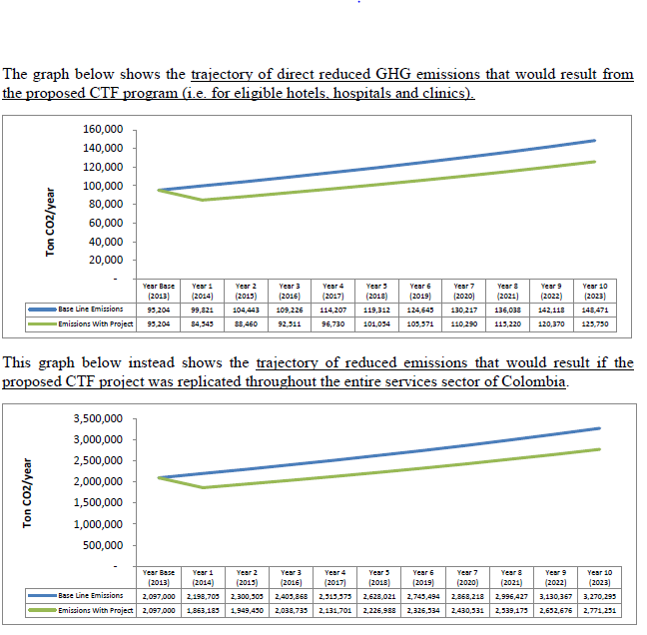
CIF EXPERIENCE: National Development Banks
Colombia: Energy Efficiency Financing Program for the Services Sector
Trajectory of direct reduced GHG emissions that would result from the proposed CTF program
Trajectory of direct reduced GHG emissions that would result if the proposed CTF project was replicated throughout the entire services sector of Colombia

Slide 15
CIF EXPERIENCE: National Development Banks
Colombia: Technological Transformation Program for Bogota’s Integrated Public Transport System
Other Financing: $40 million (estimated leverage)
MDB Partner: Inter-American Development Bank
Implementing NDB: Bancóldex (Banco Colombiano de Desarrollo Empresarial y Comercio Exterior) [Colombian Bank for Business Development and Foreign Trade]
Funding Structure: The CTF funds will be channeled through Bancóldex to finance a series of sub-loans aimed at the acquisition of clean technology buses for the SITP. Bancóldex will be the source of financing for IFLs, which in turn will directly finance SITP concessionaires firms through credit lines. Under this program, Bancóldex and the IFLs will co-finance each one of the vehicles in equal parts. This means that the US$40 million of this program will leverage an equal amount, for a total of US$80 million. Funds will be offered with attractive financial conditions and will contribute to compensate the price difference regarding the starting cost of clean technologies.

Slide 16
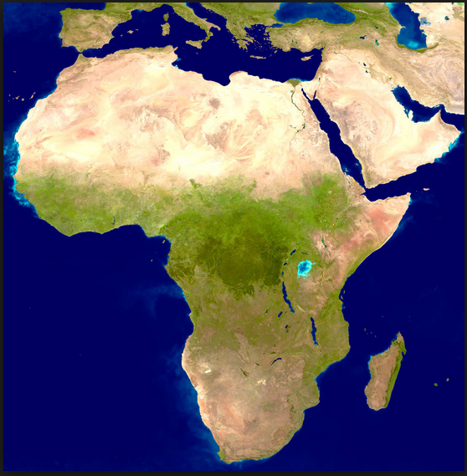
Recent Developments
June 2014:
14 new pilot countries selected for the SREP bringing total number to 27
CTF: Dedicated Private Sector Programs
6 approved programs for a total of USD 508.5 million
Phase I
Utility-Scale Renewable Energy (with a focus on utility-scale geothermal energy) USD 115 million
Renewable Energy Mini-Grids and Distributed Power Generation USD 35 million
Phase II
Utility-Scale Renewable Energy (geothermal energy) USD 120 million
Renewable Energy Mini-Grids and Distributed Power Generation 53.5 million
Mezzanine Finance for Climate Change Program USD 35 million
Utility Scale Renewable Energy (private and early stage renewable energy power) USD 35 million
Utility Scale Renewable Energy (solar PV) USD 95 million
Energy Efficiency and Self-Supply Renewable Energy USD 20 million
SCF: Private Sector Set Asides
21 total endorsed projects totaling approximately USD 189 million

Slide 17
CIF Experience with NDBs
Engagement with local financial institutions (NDBs and commercial FI’s) still a small share of CIF portfolio
Most of the CIF NDBs portfolio concentrated in Latin America under IDB leadership
Engagement with only a few NDBs in middle-income countries (NAFINSA, Bancoldex, TKB)
While…
NDBs are key if we are to meet the global climate change goals because of knowledge on local barriers to investment; capacity to take more risk than others and working at smaller scale
For stronger engagement from NDBs it might be necessary to provide them with a clear climate mandate; build their capacity to access international climate funding; structure climate relevant deals and monitor, report and verify

Slide 18




THANK YOU
www.climateinvestmentfunds.org
@CIF_Action
https://www.youtube.com/user/CIFaction
https://www.flickr.com/photos/cifaction/sets

