Slide 1


Innovative Financial Instruments to Support Energy Efficiency: Experiences from Financial Institutions in Latin-American and Asia-Pacific Regions
Promoting EE in hotels and tourism sector

Slide 2

BANCOMEXT
Banco Nacional de Comercio Exterior, S.N.C.
The Export Credit Agency of Mexico
Established in 1937
Mexican EXIMBANK
Mandate to finance Mexican foreign trade
According to its Organic Law, Bancomext’s obligations are fully guaranteed by the Mexican Government

Slide 3

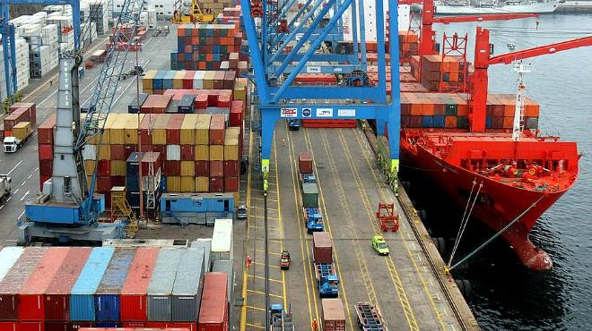
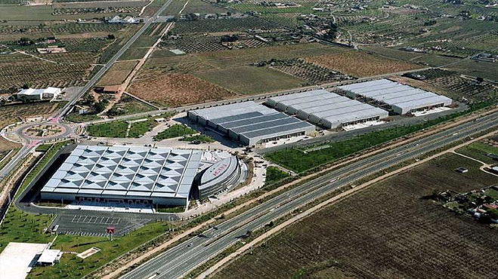
Activities That We Support
Export finance
Import finance
Internationalization of Mexican businesses
Support for foreign investment
Value chain integration, in order to increase the national content in Mexican exports
Our goal is to contribute increasing productivity in mexican companies

Slide 4


Business Model
First tier
Direct credit
Financial needs above USD 4 million
Sectorial approach to businesses
Second tier
Credit through financial, banking and non-financial intermediaries
Financial needs for up to USD 4 million
Credit guarantees for SMEs

Slide 5




Guarantee Programs
To encourage financing in commercial banks of:
Operations and projects related to foreign trade
Objective
Companies in sectors or regions related to foreign income generation
TOURISM
ELECTRIC & ELECTRONIC
Key Sectors
AUTOMOTIVE & AUTO PARTS
ENERGY EFFICIENCY
Guarantee
Types
Case by Case
Automatic

Slide 6
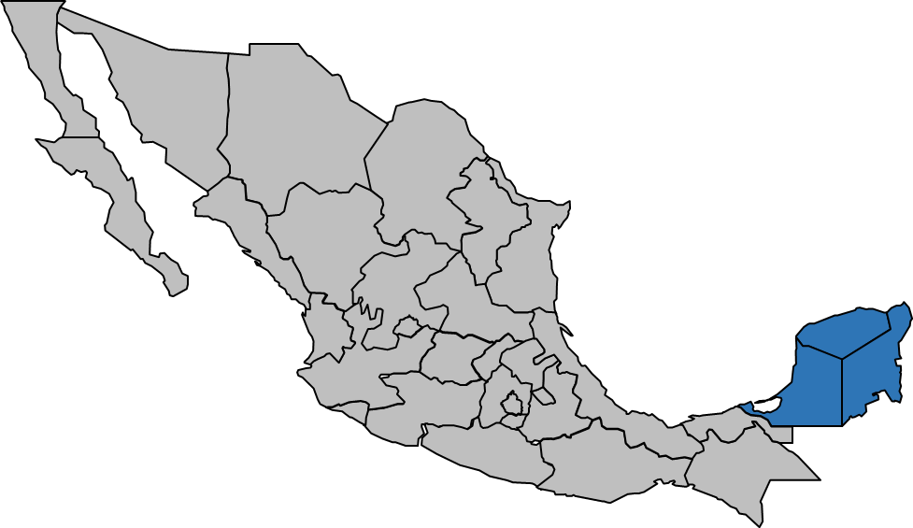

Financial pilot mechanism for solar water heating system in the Yucatan peninsula

Slide 7


CONUEE
National Comision for Efficient Use of Energy (CONUEE) is a descentralized administrative entity of Energy Minister (SENER) with technical and operative autonomy.
The purpose is to promote the energy efficiency and become a technical entity in sustainable use of energy field.
The main sectorial programs which CONUEE focus on:
  SMEs: Introduction of practices to reduce energy consumption.
  Solar water heating: Promote the optimal use of solar energy, fostering good practices in energy rational use and reduction of polluting emissions.
  Mobility and transport: Efficient use of transport systems, trough technical assistance to optimize the management and vehicle fleets operation.

Slide 8
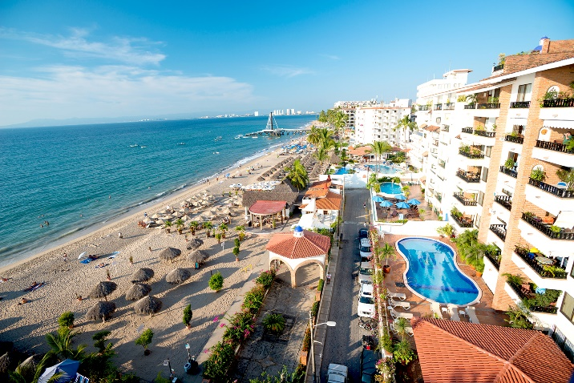
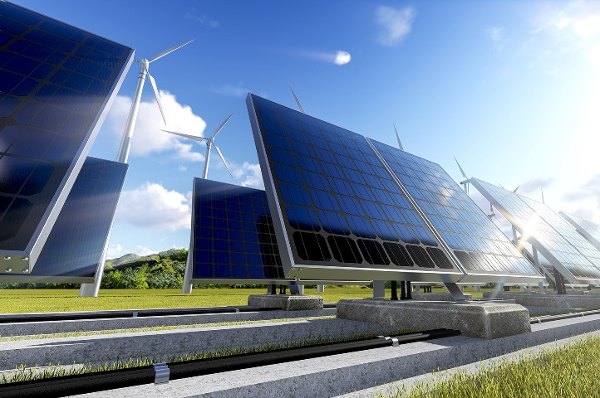
Terms
Purpose
Foster the solar water heating system use
Scope
Small and medium sized hotels in Yucatán Peninsula (Campeche, Yucatán and Quintana Roo)
Functions
CONUEE: Technical and economical certainty
UNDP: Local office from operative process
BANCOMEXT: Credit guarantee
Execution Period
2 years
Notes:
UNDP: United Nations Development Programme (Programa de las Naciones Unidas para el Desarrollo).

Slide 9
General Conditions of Financing
Operator Bank: Mexican Commercial Bank
Credits amount: Financial needs for up to USD 0.80 million
Purpose: Purchase and instalation of solar water heating systems
Types of Financing:
  Currency: Mexican Pesos
  Term: Up to 5 years
  Guarantee: personal obligation.
Interest Rate: Will be analized case by case
9,000 square metres of SWHS installed
Equivalent ~ 3,000 hotel rooms
Annual energy saving ~ 8,100 MWth
Annual economical saving ~ USD 0.32 million per SWHS
Reduction ~ 1,840 Ton of CO2 annual
Expected Results
Notes:
SWHS: Solar Water Heating System (Calentadores Solares de Agua).
CO2: Carbon Dioxide.
MWht: Mega Vatio por hora térmicos
En términos de equivalencia, el ahorro de 8,100 MWht implica dejar de utilizar cerca de 1,160,000 Biolers de paso con capacidad equivalente a 6 litros.
Ahorro anual:

Slide 10


Benefits
Technical and economical advice in fuel reduction savings derivates of SWHS use
Suppliers technical guarantee, which provides and installs technology
Periodic evaluation of CO2 reductions and fuel savings
Notes:
SWHS: Solar Water Heating System (Calentadores Solares de Agua).
CO2: Carbon Dioxide.

Slide 11

“With every credit, we are moving and transforming Mexico”
  Fernando Hoyo Oliver
  Deputy General Director
  Small Business Development
  www.bancomext.gob.mx
¡Thank you!

