Slide 1





Energy Savings Insurance

Slide 2
The Agenda for this Presentation
To be covered
Stakeholders
The ESI Program
Financial resources
Program Status
Knowledge Sharing & Partnering
Program Methodology
Monetize Energy Savings

Slide 3

Why is ESI being deployed?
The obstacles ESI overcomes
Lack of Finance
High Risk Perception
Scarcity of products to finance energy efficiency and greener technologies.
Performance risk, technical risk and uncertain returns among others.
Information Faults
No EE Experience
Assymetric and imperfect information send erroneous signals to potential stakeholders.
Lack of experience in the implementation of EE projects.
Low Demand
No interest or low priority on EE on the demand side.
Notes:
The Energy Savings Insurance (ESI) Program overcomes these barriers to investment in EE through the implementation of risk mitigation instruments, its innovative approach is to provide an insurance product that covers projected energy savings for specifically defined and verifiable EE measures as agreed upon in a standard contract between SMEs and technology services providers (TSPs). Its risk-sharing mechanisms compensate firms in the event that promised financial flows associated with EE savings are not realized.

Slide 4



What is ESI?
Mutual benefit and EE
Trust building
GHG mitigation
FIs
TSPs
SMEs
EE investments leverage
Equipment modernization
CAPEX optimization
Notes:
The energy savings insurance is a financial risk mitigation instrument that helps to build trust
between TSPs and firms, and FIs and firms. The insurance acts as the guarantor of the
contract’s performance guarantee and pays a firm the performance guarantee in case a TSP
fails to fulfill its commitment. This instrument reduces a borrower's (a firm’s) risk for credit
payment default.

Slide 5
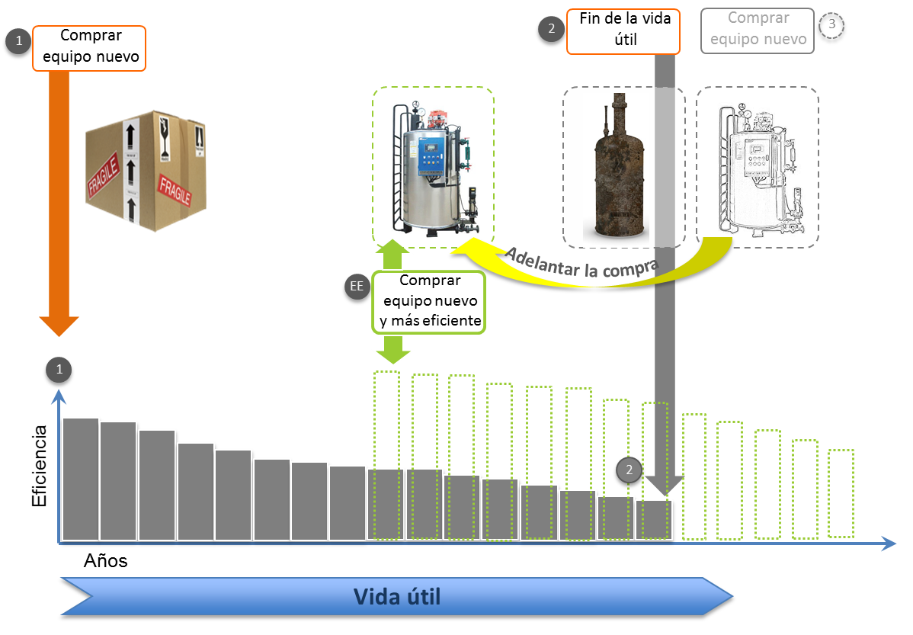
Really, what is ESI?
ESI substitutes inefficient equipment in SMEs
Notes:
With its mechanisms deployed, ESI enhances: i) potential private sector investors to feel confident that their EE projects will generate enough energy savings to pay for the loans assumed and eventually make a profit; and ii) local financial institutions become more aware of the real risk and returns associated with these projects and hence increase their willingness to finance them.

Slide 6

Energy and savings
Efficiency calculation
Accuracy
Transparency
Consistency
Simplicity

Slide 7
What about cash flows for SMEs?
ESI guarantees energy savings that pay the loan acquired by SMEs
Notes:
With its mechanisms deployed, ESI enhances: i) potential private sector investors to feel confident that their EE projects will generate enough energy savings to pay for the loans assumed and eventually make a profit; and ii) local financial institutions become more aware of the real risk and returns associated with these projects and hence increase their willingness to finance them.

Slide 8
Program methodology
Key Steps to Implement
Market Assessment
Financing Structure
Standard Contract
Validation / Verification
Promotion / Communication
Capacity Creation
Energy Savings Insurance
Notes:
The market assessment goal is to identify bankable energy savings projects that incentivize firms to decide to
invest in such a project due to its profitability either with own resources or through loan
Resources.
The financing structure aims to provide financing with competitive and suitable long-term
financing conditions and tackle the lack of financing for EE projects and SMEs. Furthermore,
it is important that the financing is structured to lower the firms’ annual energy and
financing cost, and to ensure that the financing conditions incentivize SME firms to investing
in these types of technologies.
The standardized performance contract overcomes the trust barrier through the
establishment of the “rules of the game”. This is in a market where firms are not used to
buying future energy saving promises and where providers are not used to selling
guaranteed energy savings. Furthermore, the contract also provides the framework for
negotiations between the firm and the TSP and establishes the guarantees and risk
mitigation instruments that improve the credit evaluation process and access to financing.
The validation procedures help to build trust between TSPs and firms, and between firms
and FIs and insurance companies. A third party expert in EE technology conducts the
validation procedures and evaluates the capacity of the project to generate the energy
savings promised.
The promotion/communications plan addresses the lack of priority placed on EE projects
by providing convincing arguments in an accessible way to the target firms.
The capacity building efforts overcome the lack of experience of TSPs and FIs in dealing with
EE projects and in realizing them. Additionally, this mechanism also helps to overcome the
priority barrier as it aims to build TSPs’ and FIs’ understanding of energy efficiency
investment opportunities and risk mitigation instruments.
Finally the insurance mechanism which builds trust between stakeholders.

Slide 9
Regional learning
Achievements and lessons learned applied
5
Happier Stakeholders
Peru
Better Approach
More Confidence
Faster replication
4
Implementation Pace
Cumulative know how
Budget Optimization
Instruments improvement
Brazil
3
Prefeasibility
Standard Contract
Insurance Mechanism
Validation Methodology
El Salvador
2
1
Mexico
Colombia

Slide 10
Financial Resources to NDBs
Funds allocation per NDB per country
So far, approximately USD 700,000 disbursed
Replication to other NDBs is being approached
External funding to scale up the Program (GCF, CTF, etc.)

Slide 11

Status by Country

Slide 12

Mexico
Achievements and current status
FIRA: Programme strutctured, insurance scheme defined, validation methodology tunned up, instruments ready.
FIRA: Project pipeline in development, 1 ready for contract settlement, 2 queued for validation and 5 showing interest. 80 projects have been clearly identified by the FIRA’s regional branches.
FIRA: Promotion plan developed, implementation started.
FIRA: 11 EE TSPs validated and 10 queued for March.
BANCOMEXT: Market research started, scope, methodology and details have been socialized with the consultant and representatives of the NDB. Questionnaire approved, database is currently being created.

Slide 13
El Salvador
Achievements and current status
Green Climate Fund request approved.
Standard contract 100% adapted to local framework, Bandesal giving feedback, annexes currently being fine tuned by the legal consultant. Socializing process started (commerce chamber, industrial associations, LFIs.
Validation methodologies adapted, currently being revised internally – quality control.
Insurance product being defined, Asesuiza – SURA based in standard contract.
Finance structure currently being developed.

Slide 14
Colombia
Achievements and current status
Promotion in Colombian cities with more than 300 people participating.
Programme instruments and structure ready – analyzing compensation fund administration – Fiduciary – Escrow account – Insurance company.
Insurance update, consultant currently in a mission to fine tune details with SURA.
Review of EE projects pipeline.

Slide 15
Brazil
Achievements and current status
Legal team defined and currently structuring standard contract and insurance mechanism.
Validator entities approached, currently in hiring process – ToRs.
Several TSPs approached, better understanding of the market, regulations and usual providers practices.
Settle down interests, intentions and work flow with partner NDBs.
Market studies finalizing, socialized and approved by NDBs.

Slide 16
Peru
Achievements and current status
Feasibility study completed – sectors and technologies identified and socialized with partner NDB.
Stakeholders approach currently in progress – Insurance companies (La Positiva, MAPFRE); professional associations, validators.
Market research plan, questionnaire, ToRs currently being developed, approaching candidates.
TSPs identification – currently approaching potential providers.

Slide 17
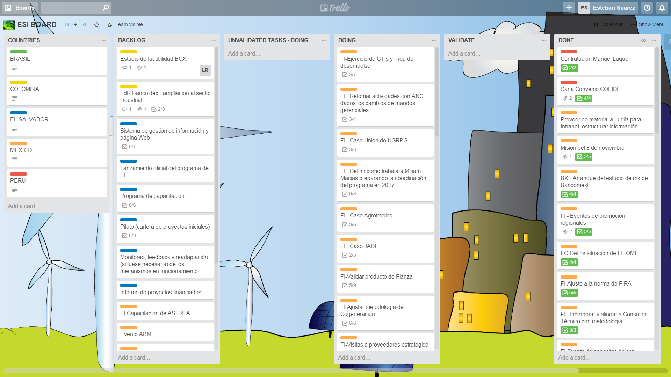
Project Mgmt. – Results Tracking
Kanban approach to PM

Slide 18
















Program Stakeholders
ESI Green Partners and Stakeholders
Validators
IFIs
NDBs
International Organizations
Insurers
Notes:
Mexico: Validator company: ANCE, insurer: ASERTA.
Colombia: Validator company: ICONTEC, insurer: SURAMERICANA.
El Salvador: Validatos: DQS, insurer: Asesuiza

Slide 19











Knowledge Sharing and partnering
Collaboration and exposure
NDBs and LFIs
Publications enhancing ESI
ESI web platform
International key actors
Climate change and EE organizations
Events / workshops

Slide 20

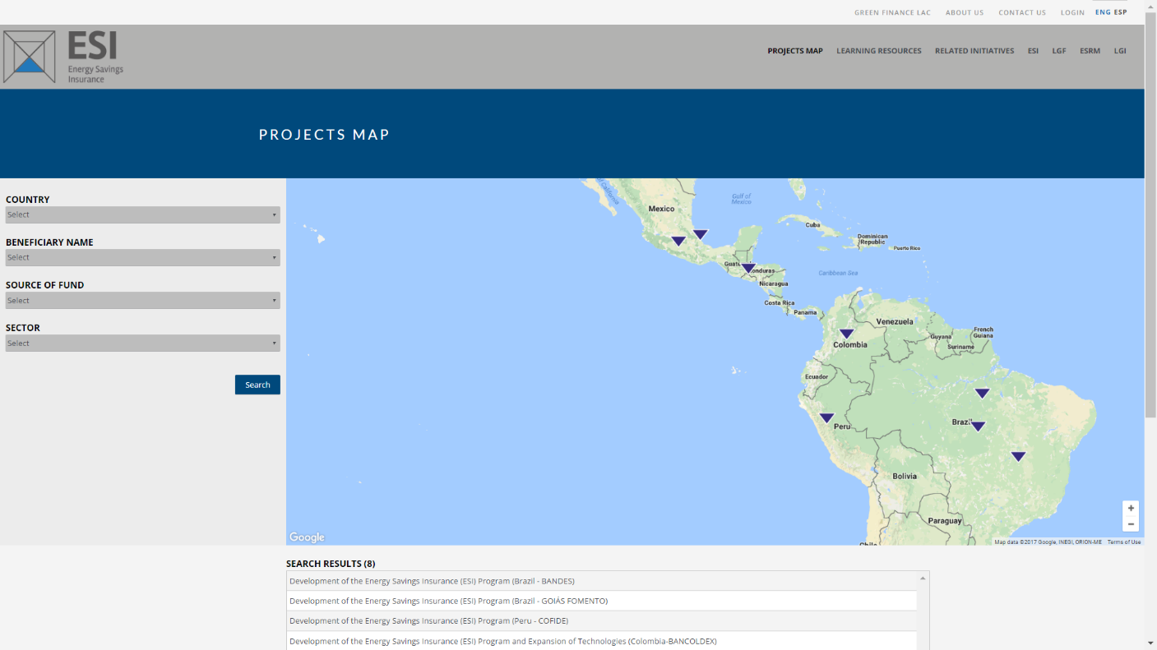
Web presence and tools
ESI Web Platform
http://greenfinancelac.org
https://intranet.greenfinancelac.org

Slide 21
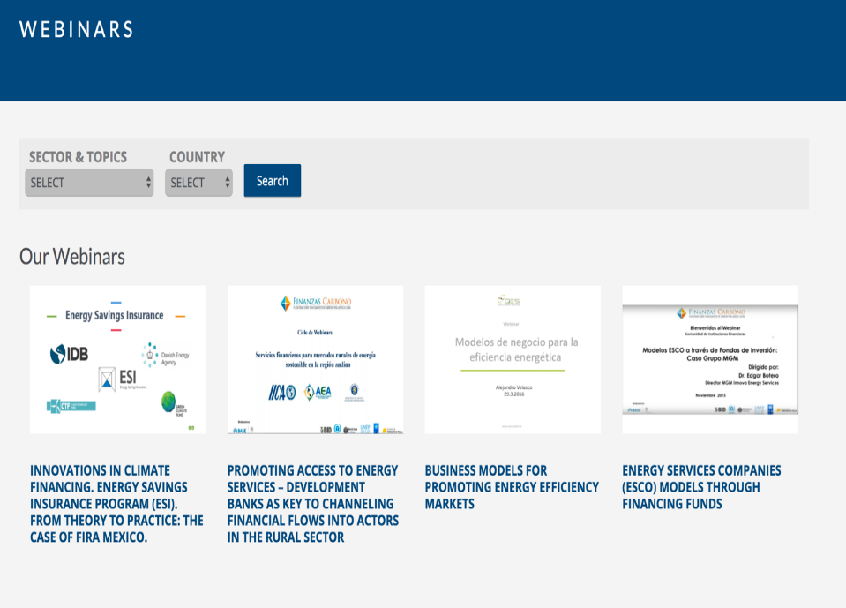
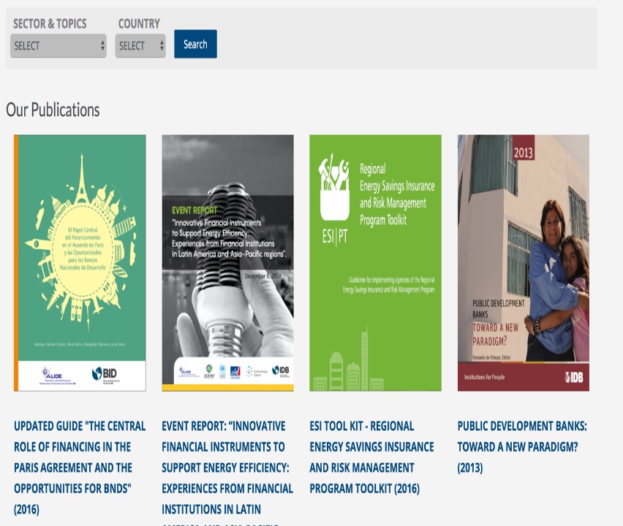
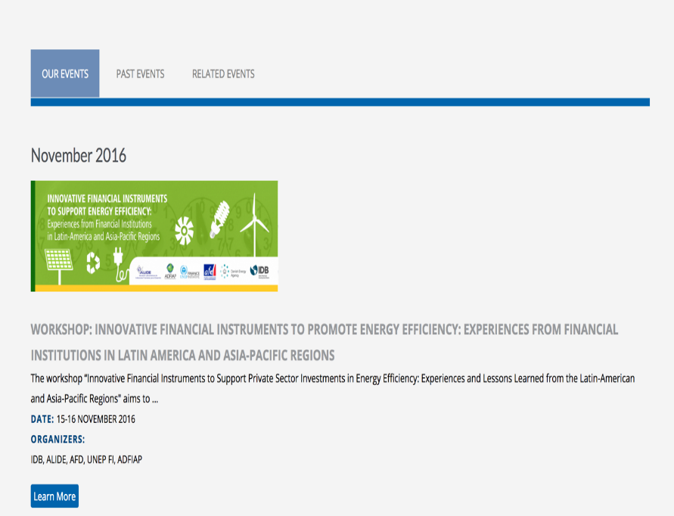
Web presence and tools
ESI Web Platform
Publications
Program Info
Webinars
News
Events
Intranet
Videos
Finance

Slide 22

Thank you
esi@iadb.org / jsuarez@iadb.org
Inter-American Development Bank
1300 New York Avenue, N.W.
Washington, D.C. 20577, USA.
www.greenfinancelac.org/esi

