Slide 1
Levaraging green finance from Green Bond issuance
Pedro Guerra, NAFIN
2017

Slide 2
Table of Contents
Presentation
Table of Contents
1. Overview 3
2. Mexico’s and NAFIN’s Commitment to Sustainability 6
Nafin’s Funded Projects Examples 14
Lessons learned 17

Slide 3
Key Instrument of Mexico’s Government Economic and Social Policy
Nacional Financiera throughout the years
1986
NAFIN’s New Organic Law was published, making it a development bank
2015
The return to international markets after 18 years with the first USD Green Bond by a Mexican issuer
2016
First MXN Green Bond in the history of the Mexican market
2009
The Sustainable Projects Unit was created to participate in the financing of environmentally friendly projects
1940
NAFIN’s first Debt Capital Markets issuance
2012
2016
1945
Begins promoting the Mexican industrialization to replace imports
2012
2015
2012
1937
First Debt Capital Markets issuance by NAFIN
2013
2012
2013
2013-2018 National Development Plan of
the Mexican government is published
2009
2012
1986
2012
2010
NAFIN becomes the 1st Mexican Bank to provide financing to a wind project in Mexico
2012
1945
1940
Dec 1940
NAFIN’s New Organic Law is published, making it a national credit institution
1980 - 1988
NAFIN was focused on providing support to companies in distress that were considered essential for Mexico
1934
NAFIN was founded with the purpose of promoting Capital Markets in Mexico
NAFINSA
To promote access to financial services
for MSMEs
To promote the development of sustainable and strategic projects for the country
To develop the stock market
To act as the Mexican Government Financial Agent
NAFINSA
as Renewable Energy Bank
Clean Energy
Wind
Solar
Hydro
Geothermal
Non Renewable Energy
Gas pipelines
Cogeneration
Mission

Slide 4
Mexico’s Commitment
Since 2009, with the General Law on Climate Change, Mexico has supported and shown strong leadership on different environmental issues, including climate change and the use of renewable energies.
In March 2015, Mexico became the first developing country to formally submit its Intended Nationally Determined Contributions. Mexico followed the EU, Switzerland and Norway in laying out their commitments to reduce greenhouse gas emissions.
Additional Generation Capacity Goal, by Technology (per the 2015-2029 Electricity Program Plan)
Mexico’s Commitment to Address Climate Change
54%
~60,000 MW
46%
Climate Change Law enacted in 2012: Goal to reduce emissions by 30% with respect to the baseline ( year 2000 levels)
Energy Reform to promote investment in clean energy technology; The Federal Commission of Electricity (CFE) reduced fuel oil consumption by almost 45%, from 201,000 barrels consumption per day in 2012, to 111,000 barrels per day in 2014
Fossil Fuel “Green” Tax, a specific fee by fuel type
Mexico’s Climate Change Fund
INDC
Unconditional Reduction: Goal to reduce unconditionally 22% of greenhouse gases emissions and 51% of black carbon emissions by 2030
Conditional Reduction: Our reduction commitment expressed above could increase up to 36% of greenhouse gases emissions and 70% of black carbon emissions, subject to a global agreement addressing important topics including international carbon price, carbon border adjustments, technical cooperation, access to low-cost financial resources and technology transfer, all at a scale commensurate to the challenge of global climate change
Low - Carbon
Conventional
11%
Solar & others
Other
4%
12%
Nuclear Electric
17%
Hydro
23%
Cogeneration⁽¹⁾
Combined
Cycle
96%
37%
Wind
Source: United Nations Environment Programme and SHCP’s “Mexico’s Concrete Actions To Address Climate Change“.

Slide 5
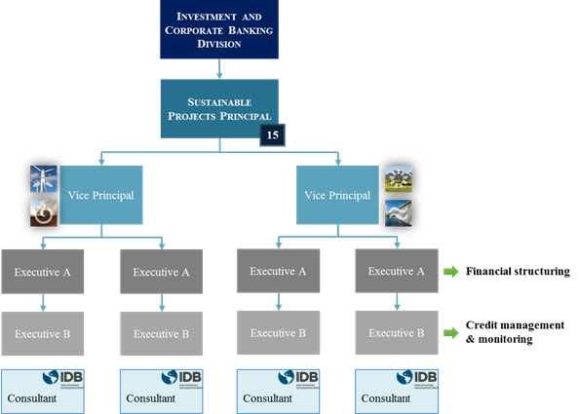

NAFIN’s Sustainability Team
NAFIN’s Sustainable Projects Department Structure
Corporate and Investment Banking Division
Currently, NAFIN’s Sustainable Projects Department consists of 15 people, including 2 external consultants hired with resources granted to NAFIN by the Inter-American Development Bank for programs focused on Sustainable Projects and Climate Change
The Sustainability Team is also in charge of doing the environmental impact reporting, e.g., the calculation of the reduction in CO₂ emissions
Color Scheme
Sustainable Projects Director
Assistant
0 105 131
15
0 165 204
Deputy Director
Wind & Cogeneration
Deputy Director
Solar & Mini-hydro
62 156 185
Credit offers to cover construction tax payments on projects
Financial Structuring
Sustainable Projects Department Objective
192 207 115
Potential local currency funding for foreign banks to fund their participation in Mexican projects
Executive A
Executive A
Executive A
Executive A
Executive A
Financing national and international companies and financial intermediaries from both the private and public sectors that promote projects in Mexico oriented toward ecological, economic and social development
253 166 26
Credit Management & Monitoring
Executive B
Executive B
Executive B
Executive B
139 110 164
Consultant
Consultant
NAFIN works closely with the Inter-American Development Bank, the United Nations Economic Commission for Latin America and the Caribbean (“ECLAC”) and the Latin American Association of Development Financing Institution (“ALIDE”)
Source: NAFIN.

Slide 6

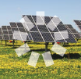

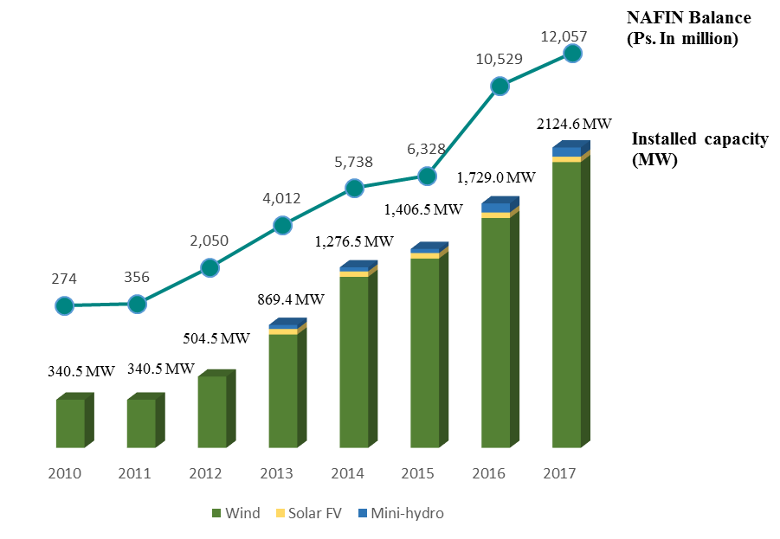
Renewable Energy Programme
NAFIN’s Financial Strategy
NAFIN’s Power Generation and Investment Balance
NAFIN has adopted innovative financial strategies to provide viability and profitability to each project
An increased number of projects have been funded and the electric power generation has grown 623% since 2010 (from 341MW to 2,124MW)
13 wind farms
2020.6 MW
1 solar farm
38.6 MW
2 mini-hydro plants
64.8 MW
Baja California
Coahuila
Nuevo León
Baja California Sur
Zacatecas
Nayarit
Puebla
Chiapas
Oaxaca
Source: NAFIN.
Note: Excludes Cogeneration, Solar and Hydro power.

Slide 7
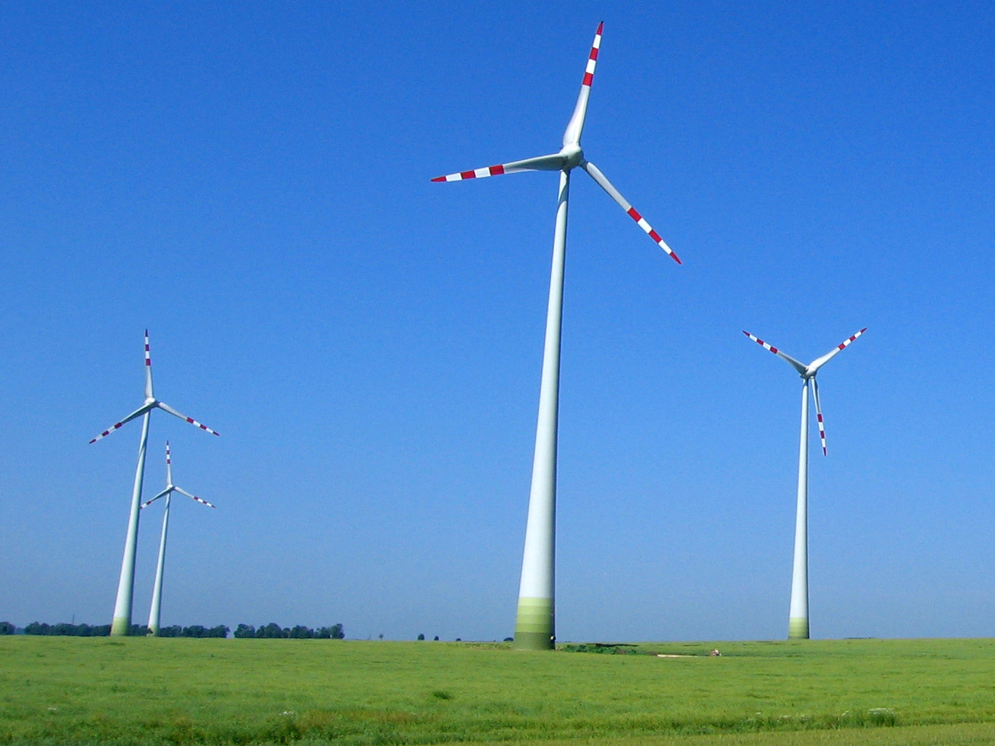
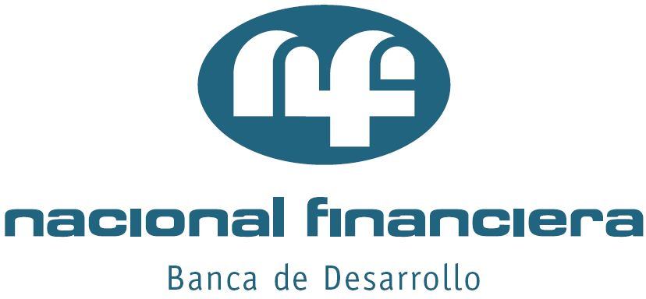
Renewable Energy Programme Output
NAFIN has been involved in 13 wind projects since 2009…
Total Investment⁽¹⁾
~US$4,011mm
13 Wind farms
838 wind turbines
Annual Power Generation: 6,636GWh
1.7 GW installed capacity, enough to cover the demand of 641,272 homes
3.04 million tons of potential CO₂ emission reductions per year
Over USD$398mm on energy loans granted
Source: NAFIN
Note: Excludes Cogeneration, Solar and Hydro power..
(1) Corresponds to the total value of the projects.

Slide 8


Green Bond Highlights
Sustainalytics Second Opinion ⁽¹⁾
First Green Bond in Mexico.
#1
"Sustainalytics considers NAFIN's Green Bond to be robust, credible and effective in reducing the GHG emissions by financing wind energy projects.”
Latin America's first Green Bond with Climate Bond Certification by the Climate Bonds Standard Board (Climate Bond Initiative).
#1
Sustainalytics B.V., evaluated NAFIN's Green Bond transaction alignment with the Green Bond Principles.
Climate Bonds Certification ⁽²⁾
"This new issuance shows NAFIN's commitment to invest in green projects and, through Climate Bonds Certification, will provide confidence to investors, assuring them the best possible way in the use of proceeds.”
"A Mexico-based bond issuance with Climate Bonds Standard Board certification sends a positive signal throughout Latin America that green bonds can be valuable source of development capital for a range of low carbon projects."
-Sean Kidney, CEO, Climate Bonds Initiative-
Bond proceeds will be solely focused on wind energy projects.
First NAFIN's cross-border debt sale in 18 years.
It is expected to be included in some of the most recognized benchmark (indexes), both for Green Bond and for Emerging Markets.
Source: Framework overview and second-party review by Sustainalytics and Climate Bonds Blog.
(1) Available on Nafin's website: http://www.nafin.com/portalnf/content/piso-financiero/relacion-con-inversionistas/green_bond.html
(2) Available on Climate Bonds Initiative website: https://www.climatebonds.net/2015/11/viva-mexico-viva-nafin-first-mexican-green-bond-%E2%80%93-issued-nafin-certified-under-climate-bond

Slide 9
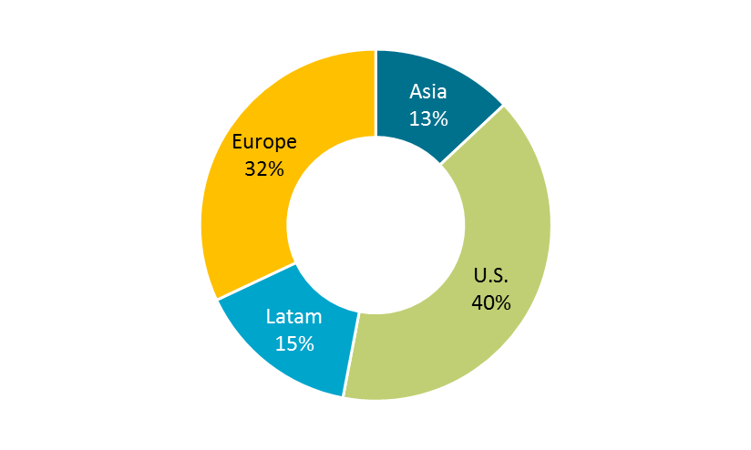
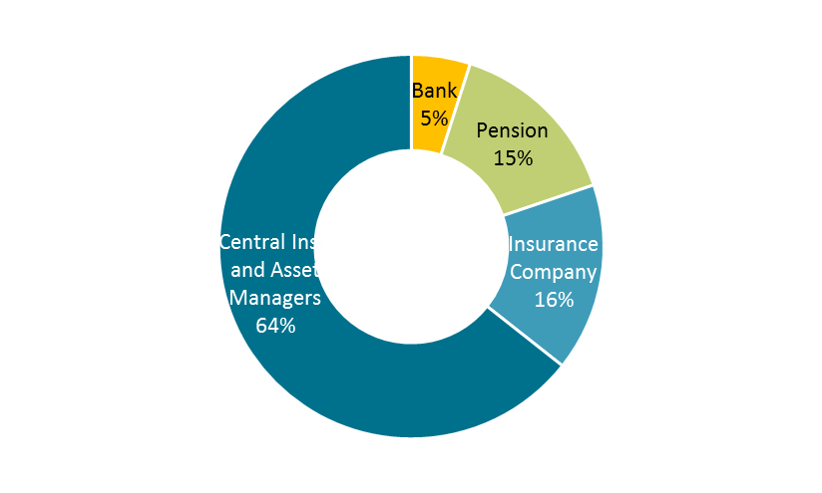
USD Green Bond Transaction Details
Final Terms and Conditions
Deal Highlights
On 29 October 2015, Nacional Financiera S.N.C (NAFIN), rated A3/BBB+(Moody's/Fitch), priced a USD 500 million 5-year Green Bond via Bank of America Merrill Lynch, Credit Agricole CIB and Daiwa Capital Markets.
Books opened on Thursday at 9am New York time with initial price thoughts of T+low 200bps. The transaction gained momentum after announcement and benefited from having high quality investors such as Central Institutions, Asian investors, Green Bond pockets and Real Money accounts immediately placing strong orders and building up a 4.5x oversubscribed book.
Following a solid investors interest, Books wre officially closed at noon New York time, followed by the announcement of official price guidance of T+195bps area (+/-5bps).
A high quality $2.5bn book post-guidance allowed the Joint Book Runners to price a $500 million transaction at the lower end of guidance (T+190bps).
Final order book was well diversified with 60 investors participating.
Daiwa focused particularly on a new demand from Central Institutions and Green investors who are not traditional buyers of Latin America, with investors taking a shine of what was the first USD Senior Unsecured bond from Latin America, allowing the Book Runners to price the transaction at the lower end of guidance and inside the Issuer´s peers curve.
All major regions were represented in the book: 40% U.S., 32% Europe, 15% Latin America and 13% Asia. Central Institutions and Asset Managers accounted for the majority of the book (65%) with Insurers, Pension Funds and Banks making up for the remaining.
This offering represents the first Green Bond from Mexico and dedicated green pockets accounted for 40% across the entire investor base.
Investor Demand by Region
Investor Demand by Type
Source: Daiwa Capital Markets, Case Study.

Slide 10

MXN Green Bond Transaction Details
Final Terms and Conditions
Deal Highlights
The Bookrunners were BBVA Bancomer and Accival Casa de Bolsa.
A well-diversified USD $ 309 million book with a demand of 2.92 times the amount issued, which allowed the transaction price to be set at a spread of 35 bps over the reference government instrument.
The book was formed by various types of investors: insurers, pension funds, government entities, development banks, corporate treasuries, brokerage firms and banks.
#1
First Green Bond in Mexcio denominated in Pesos.
Sustainalytics B.V., evaluated NAFIN's Green Bond transaction alignment with the Green Bond Principles.
The funds raised from the issue will be used exclusively to fund 2 hydroelectric plants and 1 wind farm located in Nayarit and Puebla..

Slide 11



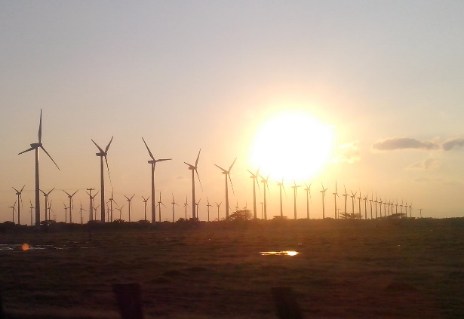
Wind Farm Oaxaca
In August 2013, NAFIN provided long-term financing of a wind farm counterpart to another in the region of 164 MW, with a joint capacity of 324 MW.
Environmental & Social Impacts
Annual production of 579GWh; enough for regular consumption of 72,100 households
Annual CO2 emission reduction of 263,000 tons
Rehabilitation of 6.5 km of local roads.
Donation of school supplies and furniture to some schools in the region.
Total Investment: MXN $5,034mm NAFIN Share: MXN $714mm (14%) Term: 14 years Installed Capacity: 160 MW
Rehabilitation of the Casa del Ejido Asuncion Ixtaltepec as part of the agreement by the right of way on land of common use of the transmission line.
Support of cultural activities and tourism promotion.
Source: NAFIN.

