Slide 1

Connecticut Green Bank
Mobilizing Private Investment
Warehousing & Securitization
National Development Banks & Green Banks
Key Institutions for Mobilizing Finance
26-27 June 2017

Slide 2
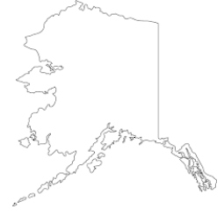
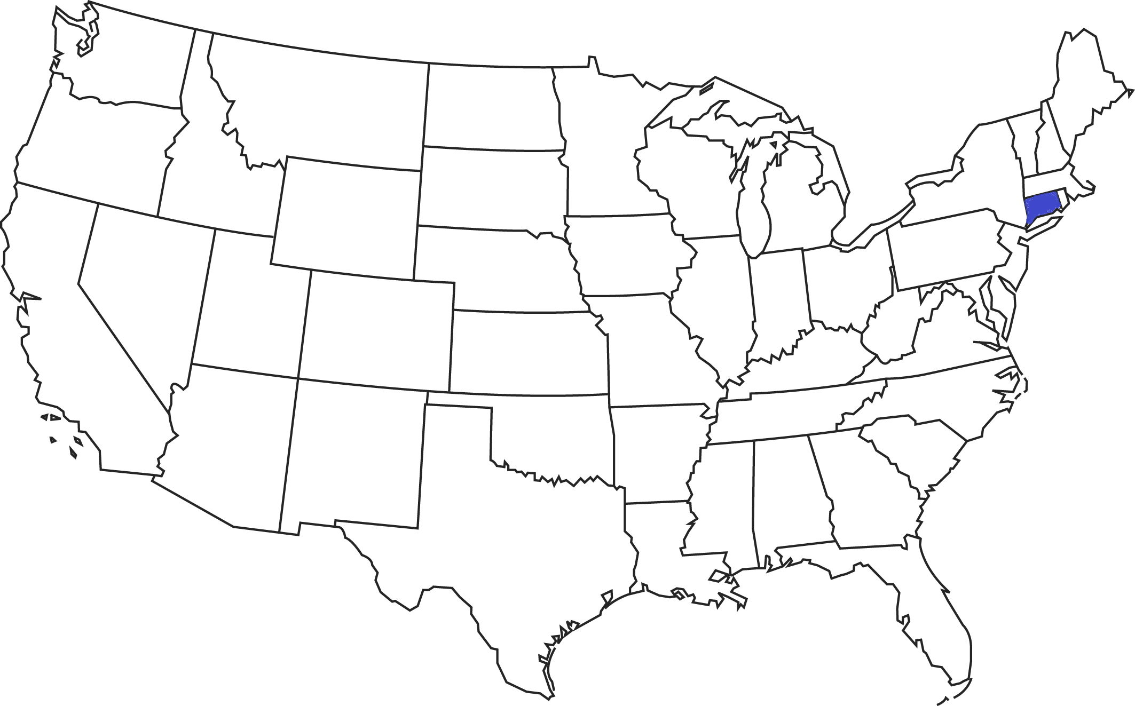
Connecticut (“CT”)
Microcosm of the United States
  Region – New England
  Population – 3,597,000
  Gross State Product – ~$225 B (#3 – 2015)
  Buildings – some of the oldest, most energy inefficient, and H&S issues
  Energy Costs – one of the highest electricity costs in USA
  Grid Reliability – 5 major storms in the past 5 years with unacceptable outages
2

Slide 3
Connecticut Green Bank
About Us
Quasi-public organization – created 2011 and succeeded the Connecticut Clean Energy Fund (1999-2011) … with ~$60 MM
Focus – finance clean energy (i.e. renewable energy, energy efficiency, and alternative fuel vehicles and infrastructure)
Balance Sheet – approximately $175 MM in assets (growing)
Support – supported by
    a $0.001/kWh surcharge on electric bills
    (~ $10 per household / year) … approximately $27 MM / year (stable)
    A “CO² Cap & Trade” … approximately $3 - $5 MM / year (stable)
    Portfolio Income … approximately $2 - $3 MM / year (growing)
    Private capital, foundations, US Govt (i.e. SunShot & ARRA) – (varies)
3

Slide 4
IMPACT! Connecticut Green Bank
Delivering Results for Connecticut
Investment – mobilized over $1 billion of investment into Connecticut’s clean energy economy so far (5 years)
Jobs – created 4,710 direct jobs and up to an estimated 12,500 total jobs, translating to an estimated 7.5% to 20% of total job creation in CT over the Green Bank’s first 5 years.*
Energy Burden – reduced the energy burden on over 20,000 households and businesses
Clean Energy – deployed more than 200 MW of clean renewable energy helping to reduce 2.5 million tons of greenhouse gas emissions that cause climate change
REFERENCES
*62,500 private non-farm jobs created in the state over 5 years since Green Bank creation mid-2011. Green Bank statistics are in job-years; “total jobs” include direct, indirect and induced. CT DOL statistics are aggregated from monthly point-in-time estimates. CT Department of Labor - http://www1.ctdol.state.ct.us/lmi/privatesectoremployment.asp

Slide 5
How Green Bank’s
Leverage Public Capital with More Private Capital
Co-Investment
Credit Support
Warehousing
Green Bank Capital
Senior Private Capital
Projects
Green Bank Credit Enhancement ¹
Green Bank Origination
Project(s)
Private Capital
Private Purchase of Portfolio
Project(s)
¹ Guarantees, loan loss reserves, subordinated debt, etc.
5

Slide 6



$1.5MM CT Solar Loan sold to
Mosaic (Crowd Fund) to replenish, relend capital
Crowdsourcing Platform
$ from loan repayments (20%)
Sub Debt
Debt
$
SPV
(CT Solar Loan LLC)
AGGREGATOR
Sungage
& SUB-SERVICER
$
$
$ from loan repayments (80%)
LLR
$ from loan repayments (100%)
$
Contract
PV Contractor
Monthly Loan Payment
Loan Agreement
CT Solar Loan provides local installers an important sales tool, while customers can take the 30% ITC and benefit from long-term, low cost capital that allows them to own PV
Install
Residential PV Customer
6

Slide 7

$3.5MM CT Solar Loan sold to
Reinvestment Fund (private placement) to replenish, relend capital
$ from loan repayments (20%)
Sub Debt
Debt
$
SPV
(CT Solar Loan LLC)
AGGREGATOR
Sungage
& SUB-SERVICER
$ from loan repayments (80%)
LLR
$ from loan repayments (100%)
$
Contract
PV Contractor
CT Solar Loan provides local installers an important sales tool, while customers can take the 30% ITC and benefit from long-term, low cost capital that allows them to own PV
Install
Residential PV Customer
7

Slide 8
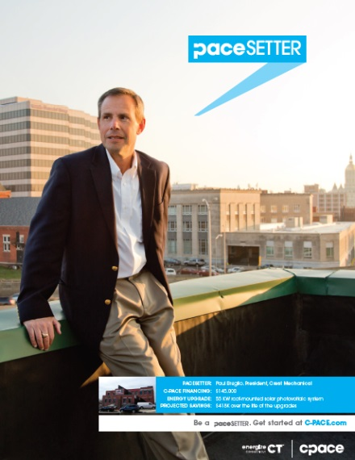

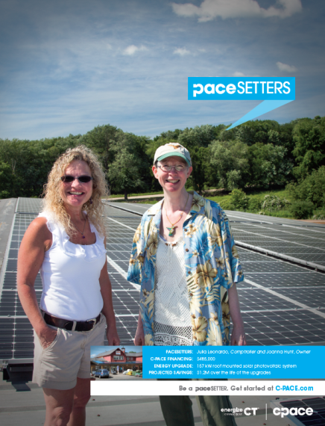


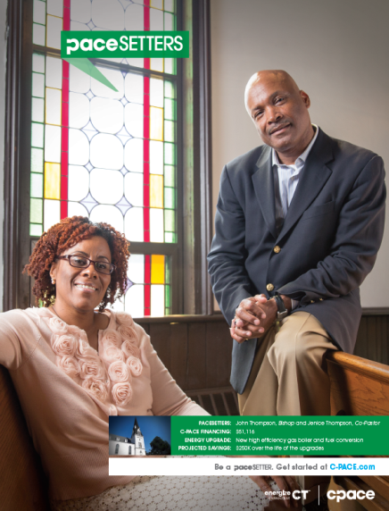
Commercial PACE (C-PACE)
Catalyst for Private Investment
8

Slide 9

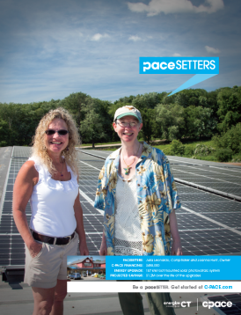


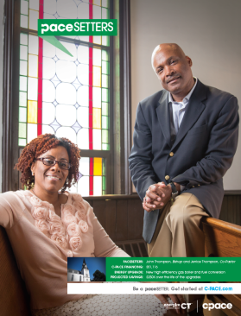

Commercial PACE (C-PACE)
Warehousing & Securitization
Connecticut Green Bank
C-PACE Warehouse ($40 MM)
Class B Bonds
(10%)
Class C Bonds
(10%)
$30 Million in Funding
Private Placements &
Ultimately Public Markets
C-PACE
Benefit
Assessment
C-PACE
Benefit
Assessment
Class A Bonds
(80%)
Clean
Fund
9

Slide 10
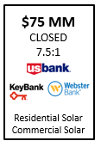
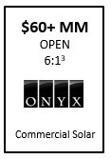
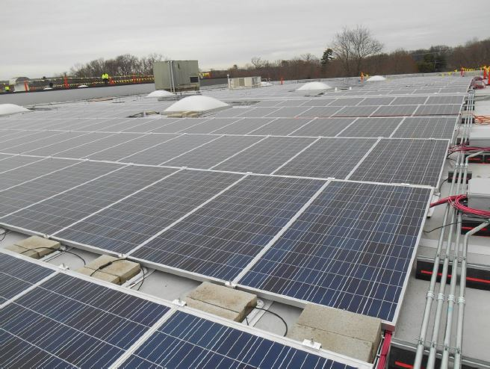
CT Solar Lease 2
Aggregation into a Solar Fund
CT Solar Lease 1 – nation’s first residential PV financing program to combine ratepayer funds with private capital to leverage federal incentives
CT Solar Lease 2 (“SL2”)
Residential
Commercial:
  Municipalities & Public Schools
  Non-profit organizations*
    Community Centers / YM-YWCAs
    Private / Charter Schools
    Houses of Worship
  “Mid-market” commercial entities*
    CRE: Office buildings, shopping centers / retail
    Heavy to light industrial
    Etc!!
  *Combined with Commercial Property Assessed Clean Energy (“C-PACE”)

Slide 11





CT Solar Lease
$75 Million Solar Fund
CT Solar Lease provides local installers an important sales tool, while customers benefit from affordable, no-money-down financing and peace of mind.
Sub Debt
Equity
Loan Loss Reserve
PBI (incentive)
Developer services
Tax Equity
System, Insurance, Lease
CEFIA Holdings, LLC
System
Contractor
(SHW, Resi. or Comm. PV)
Debt Syndicate led by First Niagara
CT SLII, LLC
Debt
$
$
Install
Assurant
Lease Payments
Insurance, maintenance, “One Call” Resolution
AFC First
PV or SHW Customer
(Resi., Comm., or Muni)
11

Slide 12



SBEA Program Funding Structure
(Small Business Energy Advantage)
Aggregation → Loan Pool → Bank Loan & Commercial Paper
Funding provided to utilities annually based on anticipated budget
Connecticut Energy Efficiency Fund (CEEF)
Provides:
Rate Buydown
Loan Loss Coverage
Admin exp coverage
(cost recovery)
Utility bills customer for loan amount
Customer repays through on-bill mechanism
Efficiency loan collected through electric utility bill
Upon collection from customers, utilities send loan repayments to SPV
Loan Losses reimbursed from Energy Efficiency Fund
Efficiency incentives
Small Biz or Muni Customers
SBEA Contractors
CGB
SPV
Efficiency
loan
proceeds
Capitalize the LLC
Capital
repayment
Efficiency projects & equipment
Capital Providers
CGB (equity)
Banks/Other Lenders
CP Investors
Security interest
CGB advances initial capital, refreshed by banks/other lenders and CP issuances
Customer and SBEA LLC enter financing agreement

Slide 13

INNOVATE EDUCATE ACTIVATE ACCELERATE
Bert Hunter
EVP & Chief Investment Officer
T 860-257-2174 | M: 203-918-0013 | F 860-563-4877
bert.hunter@ctgreenbank.com
www.ctgreenbank.com
13

