Slide 1

Development Financial Institutions Guarantees for Green Financing

Slide 2
New Macro – financial context
Uncertainties to:
Monetary policy normalization
Brexit and other political uncertainties
Highly leveraged banking, corporate and public sector balance sheets.
New Financial Regulation (Basel III)
Capital Markets underdevelopment
Large infrastructure (and climate change) needs

Slide 3
Supplies of Capital to Infraestructure Projects 2011 – 2015 in LAC Countries

Slide 4
The Role of Public Sector is key I
The role of the Public Sector is relevant in sharing risks is relevant.

Slide 5
The Role of Public Sector is key II
The role of the Public Sector is relevant specially in Payment and Revenue Guarantees

Slide 6
The role of the Public Sector is relevant specially the Transport and Energy Sectors

Slide 7
Multilateral Guarantees are an important Development
Guarantees are a key element in risk management and to mobilize private sector financing in Green Markets:
Risk disagregation
Missing Markets Development
Credit and Contract Enhancements
Manage risk according to each participant capacity or control.
New players enter into markets that would not be interested otherwise
Induces more and better financing through rating enhancement
Notes:
MY NAME IS JOAN PRATS, AND I WORK AT THE CAPITAL MARKETS AND FINAN IN CE DIVISION AT THE IDB.
I WOULD LIKE TO BRIEFLY INTRODUCE THE TOPIC OF GUARANTEES AS AN INTRUMENT FOR DEVELOPMENT GREEN MARKETS AND INFRAESTRUCTURE IN GENERAL.
GURANTEES HAVE BEEN AN INSTRUMENT THAT EVEN WHEN THEY HAVE BEEN ARROUND FOR A WHILE, THEY HAVE NOT YET COME TO BE MAINSTREAM AND PROBABLY THEY HAVE NOT YET REACH THEIR DEVELOPMENTAL POTENTIAL.
MULTILATERAL GUARANTEES AND GUARANTEES IN GENERAL HAVE ARE A KEY INSTRUMENT IN RISK MANAGEMENT THAT HELPS TO MOBILIZE FINANCING SPECIALLY IN GREEN MARKETS WHERE RISKS ARE HIGH DUE TO NEW MARKETS DEVELOPMENTS, TECHNOLOGYCAL REASONS, WHEATHER EVENTS, OR OTHERS….
GUARANTEES ARE AN EXCELENT INSTRUMENT IN ORDER TO:
1/DISAGREGATE RISK AND ALLOCATE RISK TO THOSE PARTIES THAT HAVE CONTROL OVER IT OR ARE IN A BETTER POSITION TO MANAGE IT. FOR EXEMPLE EARLY TERMINATION GUARANTEES ARE DIRECTED ONLY TO COVER THE RISK RELATED TO PAYMENTS THE GOVERNMENT HAS TO MAKE WHEN A CONTRACT IS TERMINATED AND IT IS THE GOVERNMENT FAULT. IT DOES NOT COVER ANY OTHER PROJECT OF CONTRACTUAL RISK, BUT THE FINAL TERMINATION PAYMENT. MULTILATERALS MIGHT BE A GOOD INSTRUMENTS WHEN UNCERTEINTIES RELATED TO THIS PAYMENT INHIBIT PRIVATE INVESTMENT, AS HAS BEEN THE CASE IN THE RECENT RENEWABLE ENERGEY AUCTION IN ARGENTINA.
OTHER IMPORTANT RISKS THAT MIGHT BE COVERED ARE PRICE RISK, INTERESTED RATE RISK, CONSTRUCTION RISK, AND OTHER IMPORTANT RISK FOR PROJECT DEVELOPMENT.
3/GUARANTEES CAN ALSO PROMOTE NEW MARKETS AND INVESTMENT WHEN THEY GUARANTEE CONTRACTS SUCH AS PERFORMANCE CONTRACTS OR PPAS IN CONDITIONS WHEN THERE IS HIGH UNCERTAINTY AND RISK.
2/GUARANTEES CAN ALSO ENHANCE THE CREDIT RATING OF DEBT ISSUERS, INDUCING MORE AND BETTER FINANCING.

Slide 8
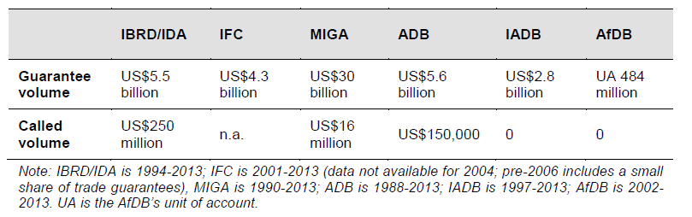
Multilaterals Guarantees are not mainstream
4.5% of total operational approval (2001 y 2013)
Volumen histórico de aprobación y ejecución de garantías
(excluye comercio)
IBRD/IDA IFC MIGA ADB IDB AfDB
≈ Only 0.6% has been called
(IFC excluded)
Fuente: Humphrey and Prizzon (2014)
Notes:
GUARANTEES ARE NOT AS POPULAR AS LOANS.
AS WE KNOW, WHEN THINKING IN MDB, AND MANY OTHER THINGS, CASH IS KING AND THIS MEANS THAT LOANS ARE PREFERED TO GUARANTEES EVEN WHEN SOMETIMES IT IS MORE EFFICIENT IN MANY WAYS THE GUARANTEE STRUCUTRE.
THEY LOW LEVEL OF CALLS OF MDB GUARANTEES, ILUSTRATE THE POINT THAT GUARANTEES ARE MAINLY TO PROVIDE CREDIBILITIY TO NEW TECHNOLOGIES AND CONTRACTUAL ARRENGEMENTS.
GOVERNMENTS ARE INCREASINGLY USING GUARANTEES IN ORDER TO IMPROVE PROJECT DEVELOPMENT. CUADRO QUE TENGO EN LA PRESENTACION DE BASE DE DATOS.

Slide 9
Guarantees improve the quantity and quality of financing
Each dollar of guarantee leveraged 4 dollars of financing
Tenor
Spread
Colombia
(PCG)
5
6.5%
10
5%
Filipinas
(PCG)
7
3%
15
2.5%
Uganda
(PRG)
0
8%
16
3.1%
Bangladesh
(PRG)
1
3%
14
2%
With Guarantee
Costa de Marfil
(PRG)
1
3%
Without Guarantee
12
2.75%
Fuente: Banco Mundial

Slide 10
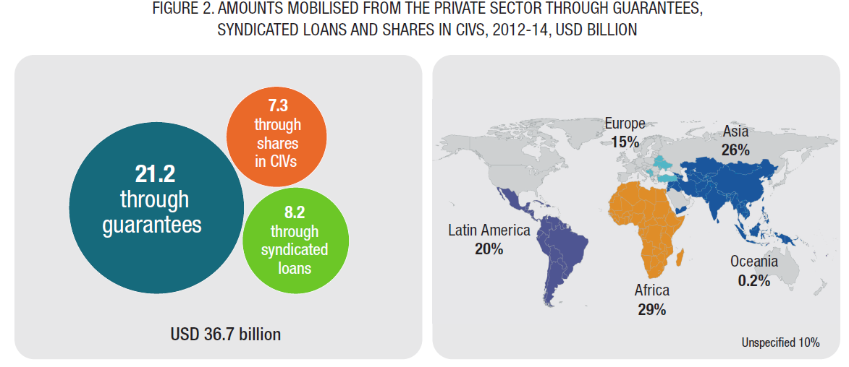
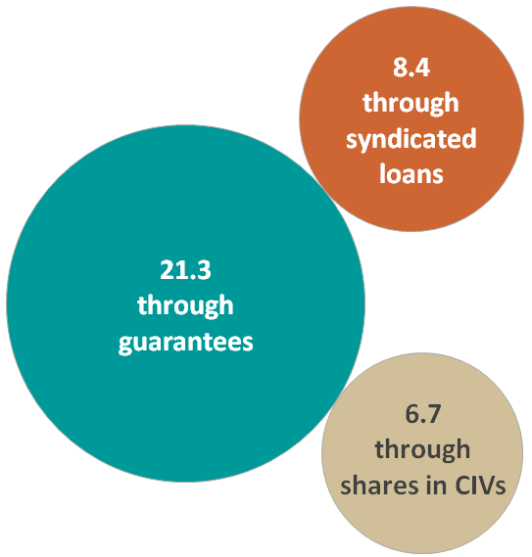
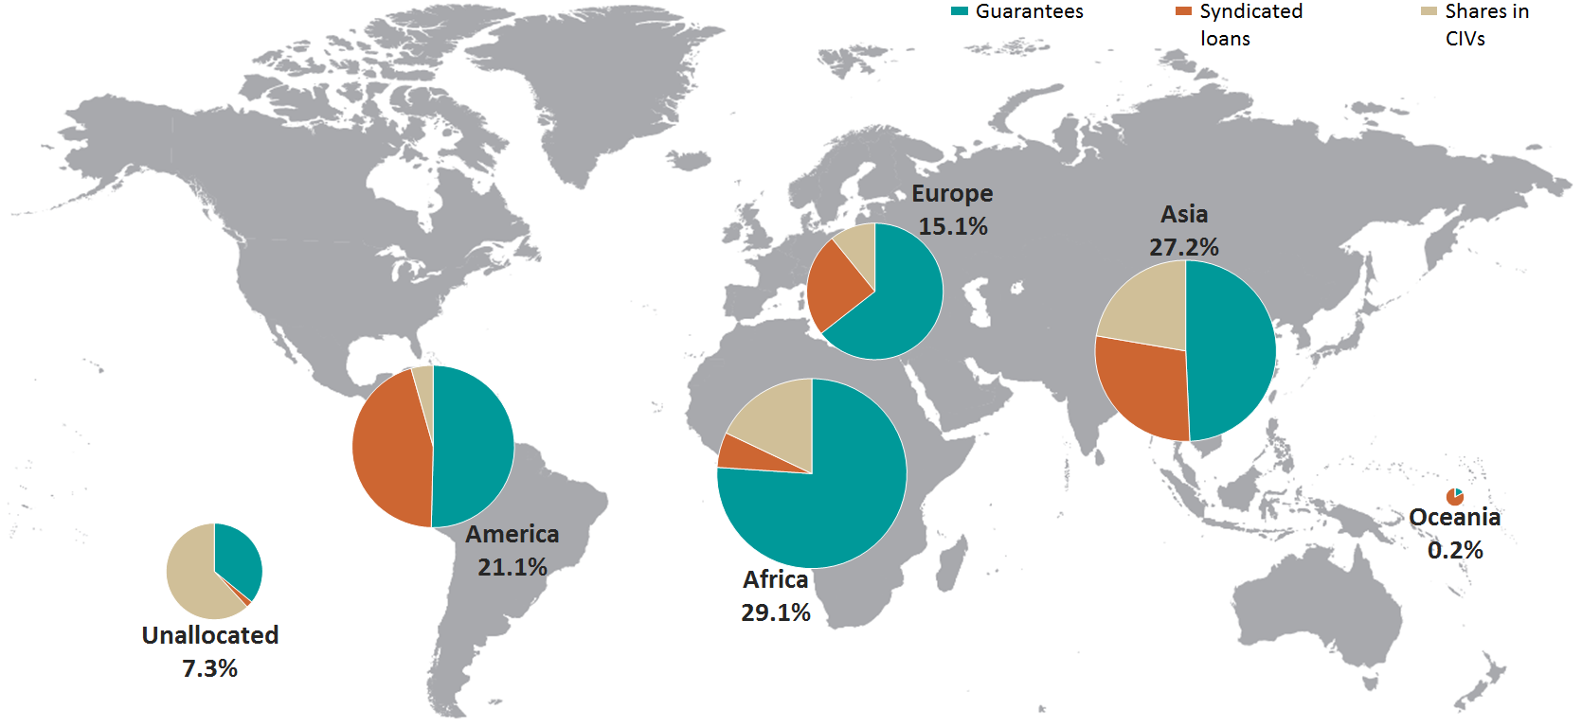
Guarantees are effective
Fuente: OECD DEVELOPMENT CO-OPERATION WORKING PAPER 26
`

Slide 11
1. Project Guarantees
Example: Covering a Public Enterprise PPA
Gobierno/Public Enterprise/Private
Contragarantía
Credit Guarantee
PPA Payment
Pagos del PA
Project Company
Debt
Comercial Bank
Debt Repaymet

Slide 12
2. Guarantee Fund
Gobierno
Contragarantía
Garantía Parcial de Crédito
Fondo de Garantías
Si el soberano lo fondea directamente, su calificación de riesgo se traspasa a la calificación del Fondo
Una garantía AAA del BID logra mayor eficiencia
Proyecto 1
Proyecto 2
Proyecto 3
Proyecto 4
Ventaja adicional: Apoyo la estructuración y debida diligencia
Notes:
- no cumplen con mínimas condiciones (tercero, sin correlación, rating)
- ocupan recursos ociosos
- pueden ser refinanciados con garantias sin aumentar deuda

Slide 13
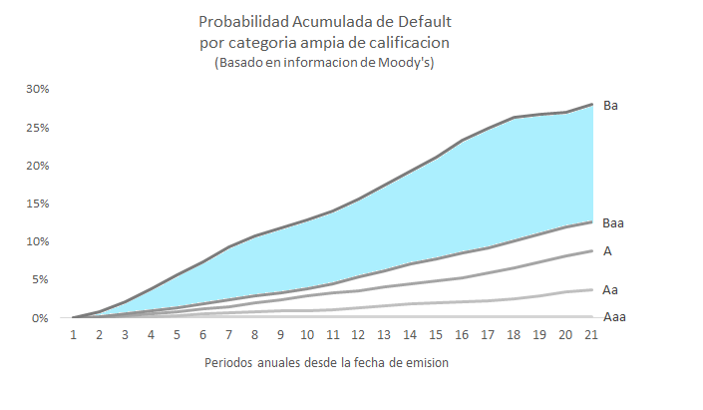
3. Guarantees for Credit Enhancement
Investment Grade
Guarantee
Bond
Perdida esperada que el garante absorbe para aumentar la calificación a Baa
Monoline industry does not longer exists

Slide 14
Non financial Benefits of Multilateral Guarantees
Contingent Liabilities
Measuring, reporting, accounting and management
Technical Dialogue
Sector oriented dialogue
Efecto demostrativo/ expansivo
Learning effects
Legal framework strengthening
Sovereign and Non Sovereign Financing
Capital markets expansion

Slide 15
Muchas gracias.

